Slide 1

Legislative Coordinating Commission
Who We Are
Non-partisan umbrella office
Legislative commissions (LCCMR, LSOHC, LCPR, LBO, others)
Staff of 40
LCC-GIS is a staff of three, provides IT support for commissions, bill research, maps, Legacy website, and redistricting.
Redistricting
Participate in 2020 Census Redistricting Data Program (BBSP, VDP)
Prepare the legislature for redistricting
Provide web access to all plans, maps, and data

Slide 2
2020 Census and Redistricting Schedule
Original Timeline
Adjusted Timeline
April 1, 2020 – Official Start of the U.S. Census
December 2020 – Census geography released
  Counties
  MCDs
VTDs
Blocks
April 1, 2020 – Official Start of the U.S. Census
January to February – Census geography released
  Counties
  MCDs
VTDs
Blocks

Slide 3
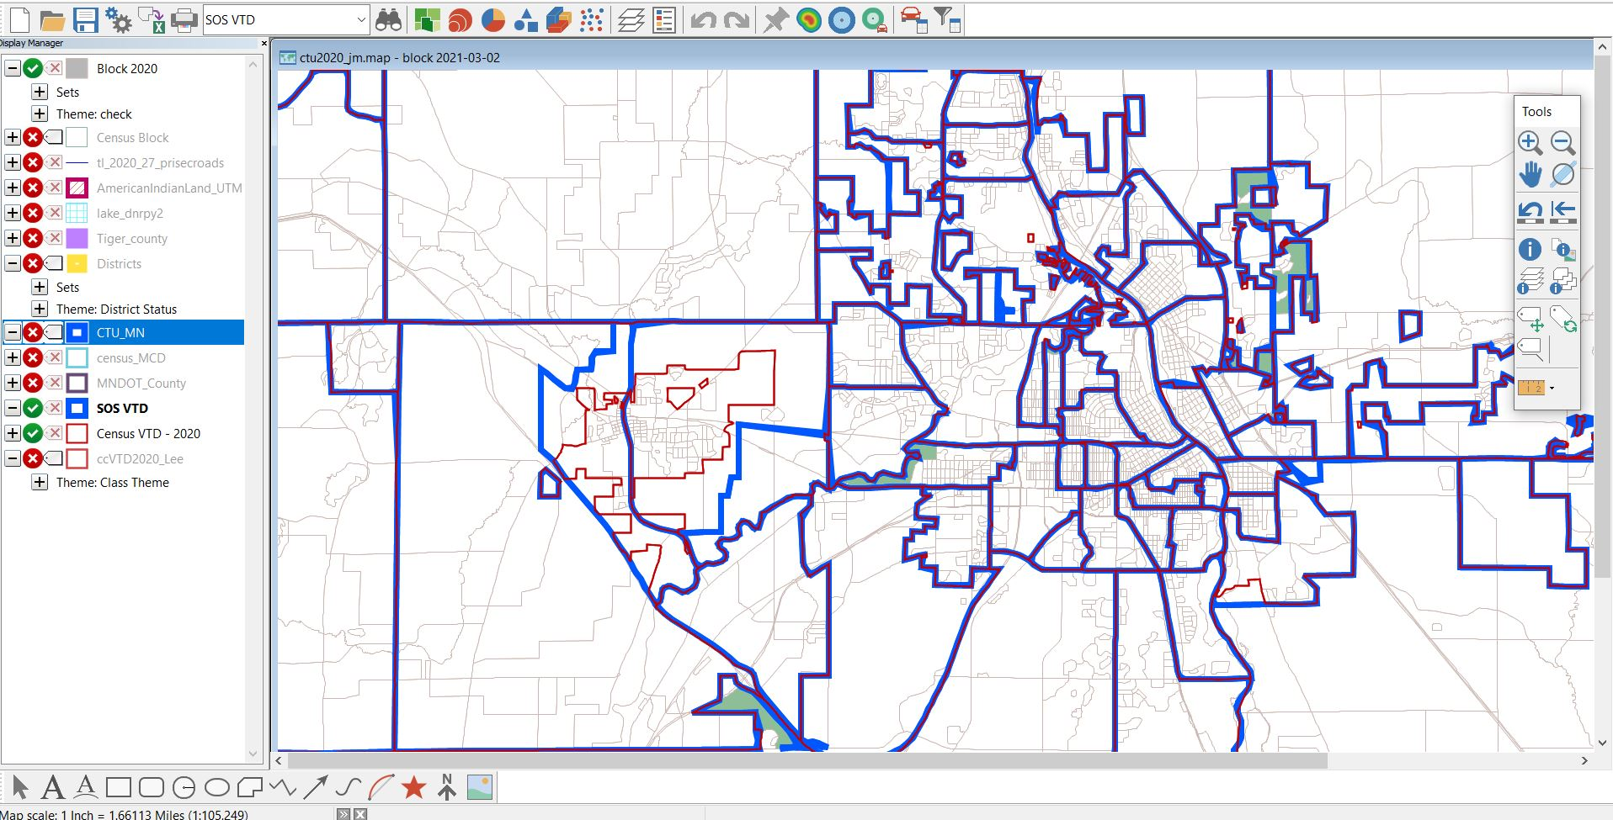

Slide 4
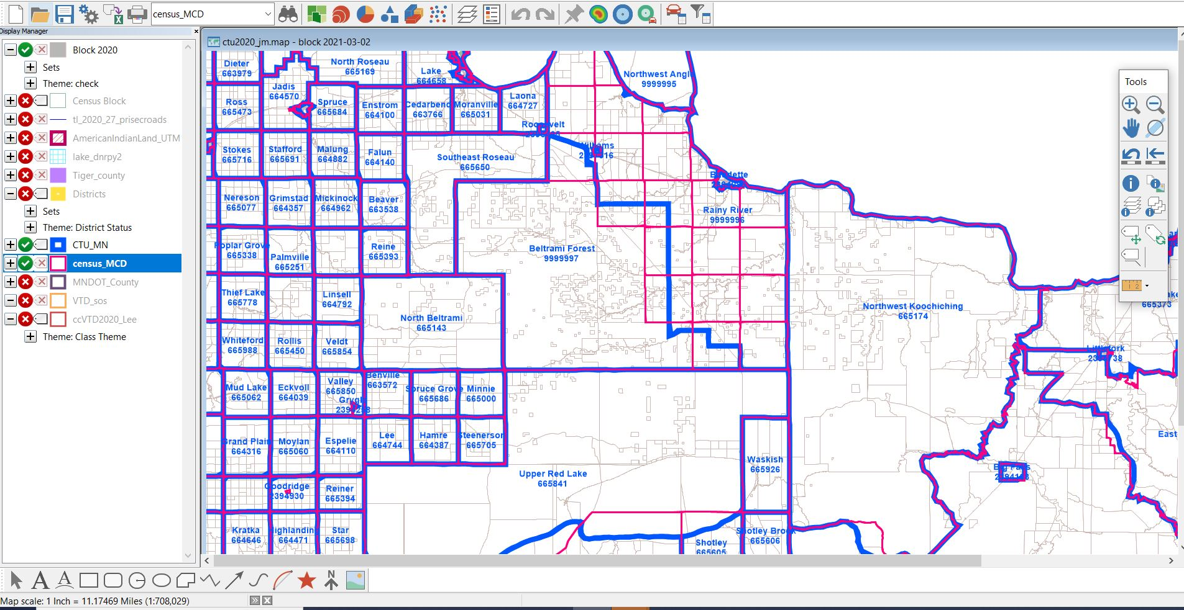

Slide 5
2020 Census and Redistricting Schedule
Original Timeline
Adjusted Timeline
December 31, 2020 – Statewide population totals, apportionment numbers.
State – 5,303,925 (2010 numbers)
Congress – 662,991
Senate – 79,163
House – 39,582
April 26, 2021 – Statewide population totals, apportionment numbers.
State – 5,706,494
Congress – 713,312 (8)
Senate – 85,172 (67)
House – 42,586 (134)
April 1, 2021 – Block-level population totals released, redistricting commences
Data posted on GIS website and Geospatial Commons
August 15-30, 2021 – Interim block-level population totals released (legacy data).
September 30, 2021 – Official release of block-level population totals.
Prepare data
Data posted to GIS website and Geospatial Commons.
February 15, 2022 – Deadline to enact congressional and legislative districts.
February 15, 2022 – Deadline to enact congressional and legislative districts.

Slide 6
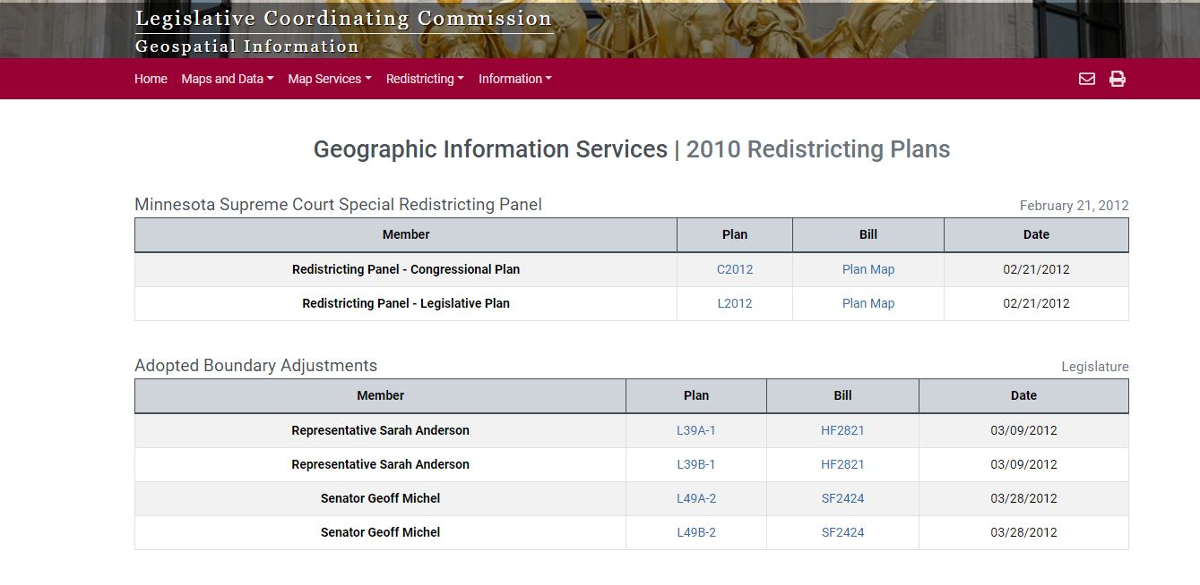

Slide 7
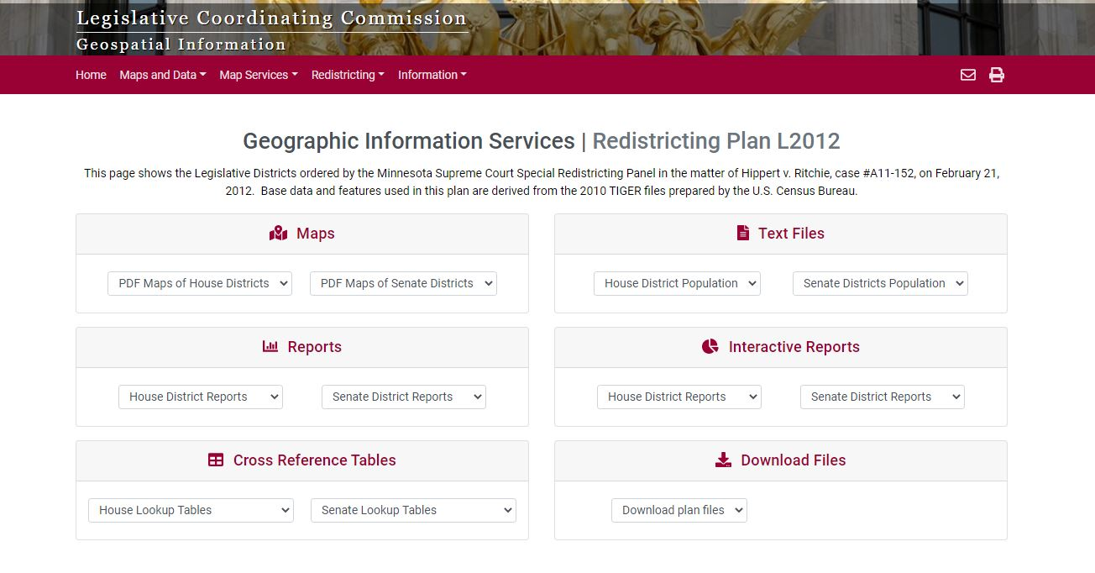

Slide 8
2020 Census and Redistricting Schedule
Where we are
2021 session review
Special session to pass a plan
January 31, 2022, beginning of legislative session.
Court appoints special redistricting panel
Metropolitan Council Redistricting
Takes place during the 2023 legislative session
Questions
gis@gis.leg.mn

