Slide 1
MetroGIS Coordinating Committee
December 8, 2022

Slide 2
MetroGIS Coordinating Committee
December 8, 2022
1 ) Call to Order
2 ) Approve Today’s Meeting Agenda
3 ) Approve Minutes from last meeting on September 8, 2022

Slide 3
4 ) Message from the incoming chair
Why I’m here
What I care about
What I hope we can achieve

Slide 4
Why I’m here…
Helping to make others successful
Saw the value of MetroGIS as its former coordinator
See the value of it from the County perspective
See the value of it as an educator and data consumer
Hear about people using our data, research, etc.

Slide 5
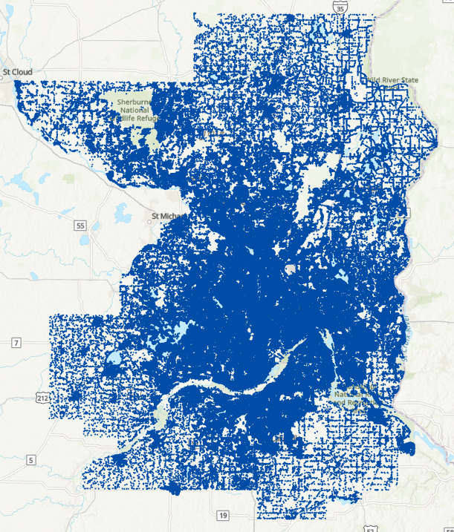
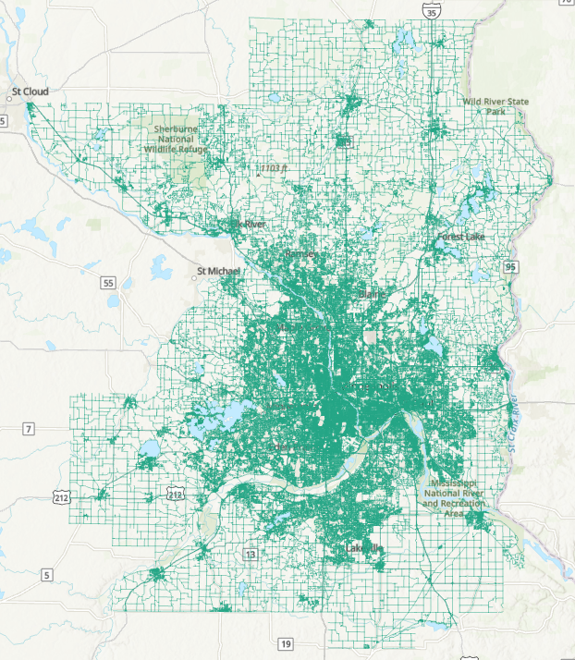
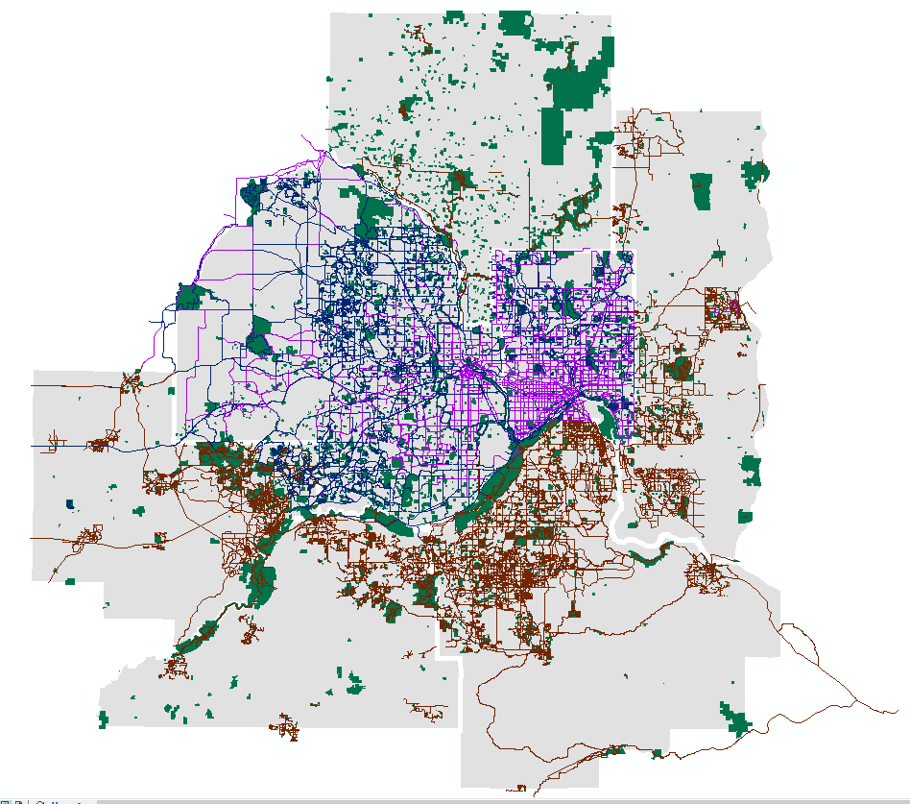
What I care about…
#1 - Regional Datasets
Stable, continued, on-going, maintenance of the regional datasets
Regional datasets remaining high quality and accurate
Ease of access and reliability of the regional datasets
< Parcels
Parks/Trails >
Address points
Road centerlines

Slide 6
What I care about…
#2 – Meet the needs of the participants
A place to communicate, discuss, and explore ideas
A place to ask for what you want and need

Slide 7
What I care about…
#2 – Meet the needs of the participants
A place to communicate, discuss, and explore ideas
A place to ask for what you want and need
#3 – Take on projects appropriate to the collaborative
Projects and initiatives to meet shared needs

Slide 8
What I care about…
#2 – Meet the needs of the participants
A place to communicate, discuss, and explore ideas
A place to ask for what you want and need
#3 – Take on projects appropriate to the collaborative
Projects and initiatives to meet shared needs
#4 – Demonstrate the value of our profession
Working together across agencies and interests to
produce work, data and projects of tangible value

Slide 9
5) MetroGIS Policy Board – Next Steps

Slide 10
5) MetroGIS Policy Board – Next Steps
Last MetroGIS Policy Board meeting was April 2019
Many former members are no longer in government
Reduced to a single, annual meeting – “show and tell”
Leadership no longer making policy or fiscal decisions
Inquire about dissolving the MetroGIS Policy Board
Report on MetroGIS activities to regional elected leadership
via the Metro Emergency Services Board + Metropolitan Council

Slide 11
5) MetroGIS Policy Board – Next Steps
On November 28, 2022, I sent a message to all remaining
MetroGIS Policy Board members
We heard back from:
Commissioner Victoria Reinhardt (Ramsey County)
Commissioner Barbara Weckman Brekke (Scott County)
Both were supportive of our assessment and proposal
We can reach out to leadership as future circumstances warrant
MetroGIS Policy Board officially ceases to exist at
12:00 p.m. on Friday, Dec 30, 2022

Slide 12
MetroGIS Policy Board
ceases to exist at 12:00 p.m.
On Friday, December 30, 2022

Slide 13
6) 2023 Work Plan, Projects, & Budget

Slide 14
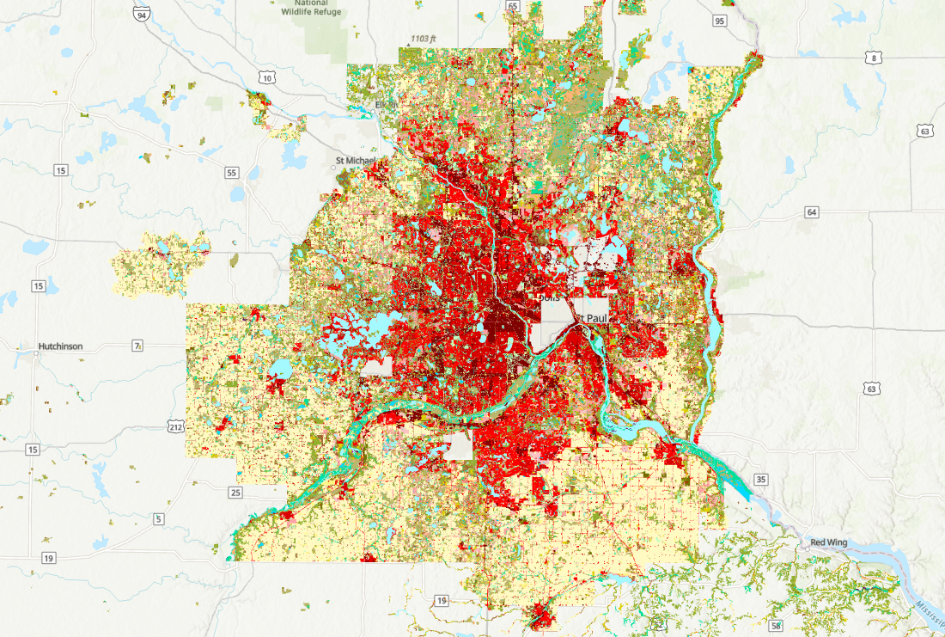
MLCCS Project
(Minnesota Land Cover Classification System)
Revised project proposal was provided by
Bart Richardson at MNDNR
Existing MLCCS data is from 2011
Metro region data is currently incomplete
MetroGIS asked to provide $26,500 in 2023 toward
new land cover data collection process

Slide 15
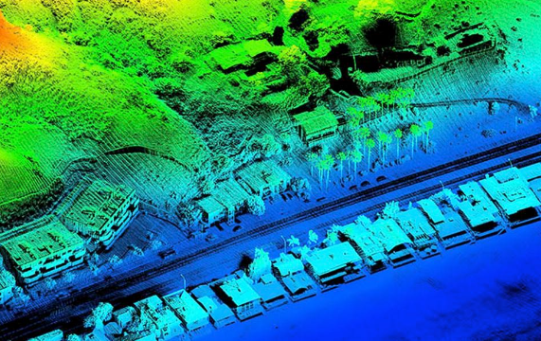
LIDAR Project Update
Jesse Reinhardt (Hennepin County)

Slide 16
2023 MetroGIS Work Plan
Details and priority level
of MetroGIS projects and activities
“Living document”
Open to suggestions, revisions, and recommendations

Slide 17
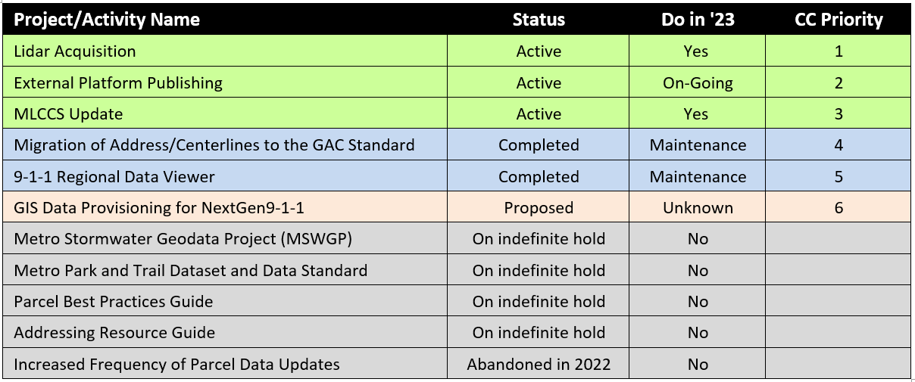
2023 MetroGIS Work Plan

Slide 18
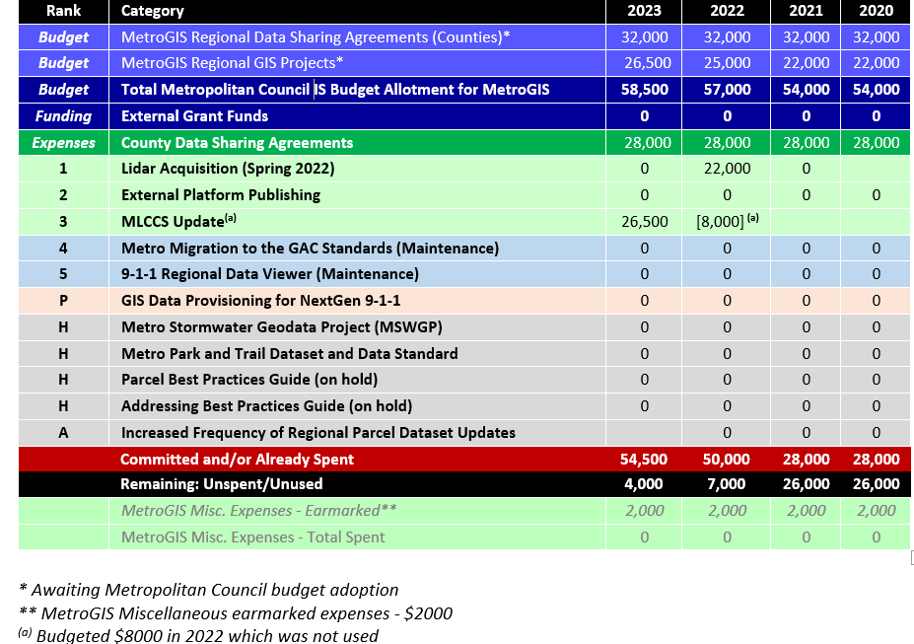
2023 MetroGIS Budget

Slide 19
2023 MetroGIS Work Plan
Approval by the
Coordinating Committee

Slide 20
7) MetroGIS Validation Enhancement Update
Jon Hoekenga, Metropolitan Council

Slide 21
MetroGIS Validation Enhancement Update
Met with county partners to review proposal on 10/31/22
Reasons for Validation Enhancements:
New features requested by counties
Expanded use of data
Incorporation into NextGen 9-1-1
Centerlines submitted to ESRI Community Maps Program
Address points desired to ESRI Community Maps Program
Technology has continued to evolve (ArcPro adoption)

Slide 22
Proposed Changes: Timelines & Priorities
Proposed Change | Impacted Datasets | Priority | Timeline
Upgrade to Pro | All | 1 | End of January 2023
Combine All Validations into One Toolbox | All | 1 | End of January 2023
Add Missing Data Check | All | 1 | End of January 2023
Enhance Space Check Messaging | All | 1 | End of January 2023
Add Multipart Check | Roads | 1 | End of January 2023
Add Sub Address Validation | Address Points | 1 | End of January 2023
Add PIN Frequency Validation | Parcels | 2 | March 2023
Add Completeness Check | Parcels | 2 | March 2023
Add Additional Tool Dangle Check Tool | Roads | 3 | May 2023
Add Additional Tool One Way Check | Roads | 3 | TBD

Slide 23
8) Processes and Communications
for
Addressing
David Brandt
Washington County

Slide 24
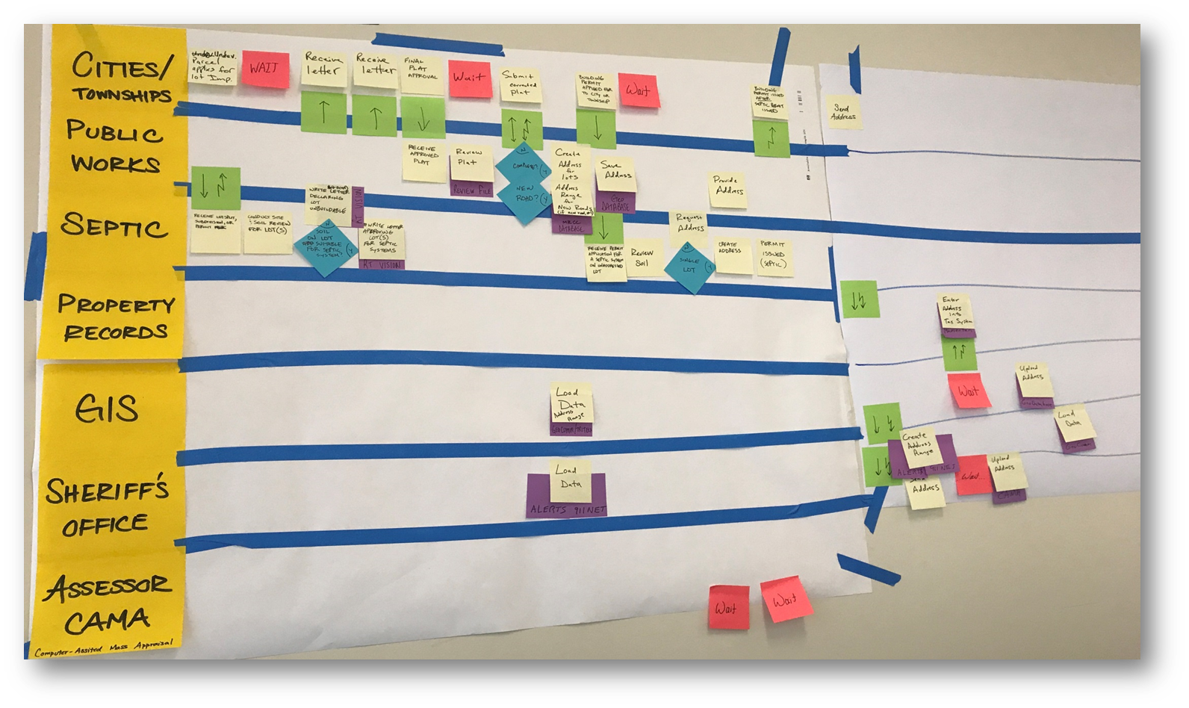
Washington County Address process
Address Flow Kaizen Event
Disconnect in communication address/address ranges
Not getting all the information needed from the cities
Townships/cities not following the addressing rules

Slide 25
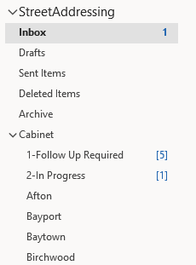
Washington County Address process
Single point of Entry
Streetaddressing@co.Washington.mn.us
Monitored by staff from Public Works, Property Records, GIS
Request entered into tracking table

Slide 26
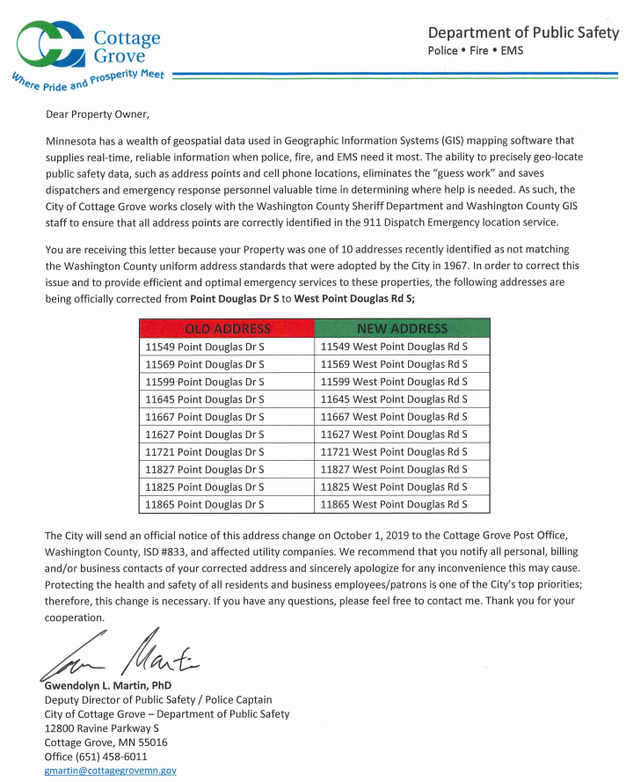
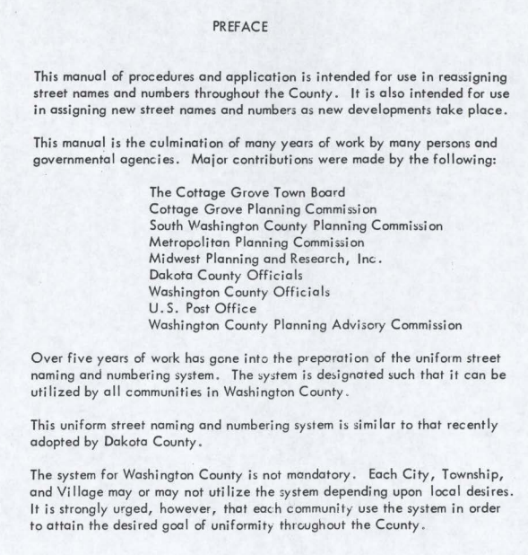
Washington County Address process
Work with cities for changes/corrections
1967

Slide 27
9) Visibility of GIS to Leadership
Persistent need for more visibility of GIS work and the GIS profession
Communicating the value of GIS/geospatial work to our departmental leadership and elected officials
External platform and 9-1-1 consumption of our data
(Long processes with big impact)
More presentations at non-GIS conferences/events
Awards/recognition of projects/individuals/departments
making contributions
Add to listing of milestones on metrogis.org web page

Slide 28
10 ) Lightning Round
11 ) Adjourn

