Slide 1
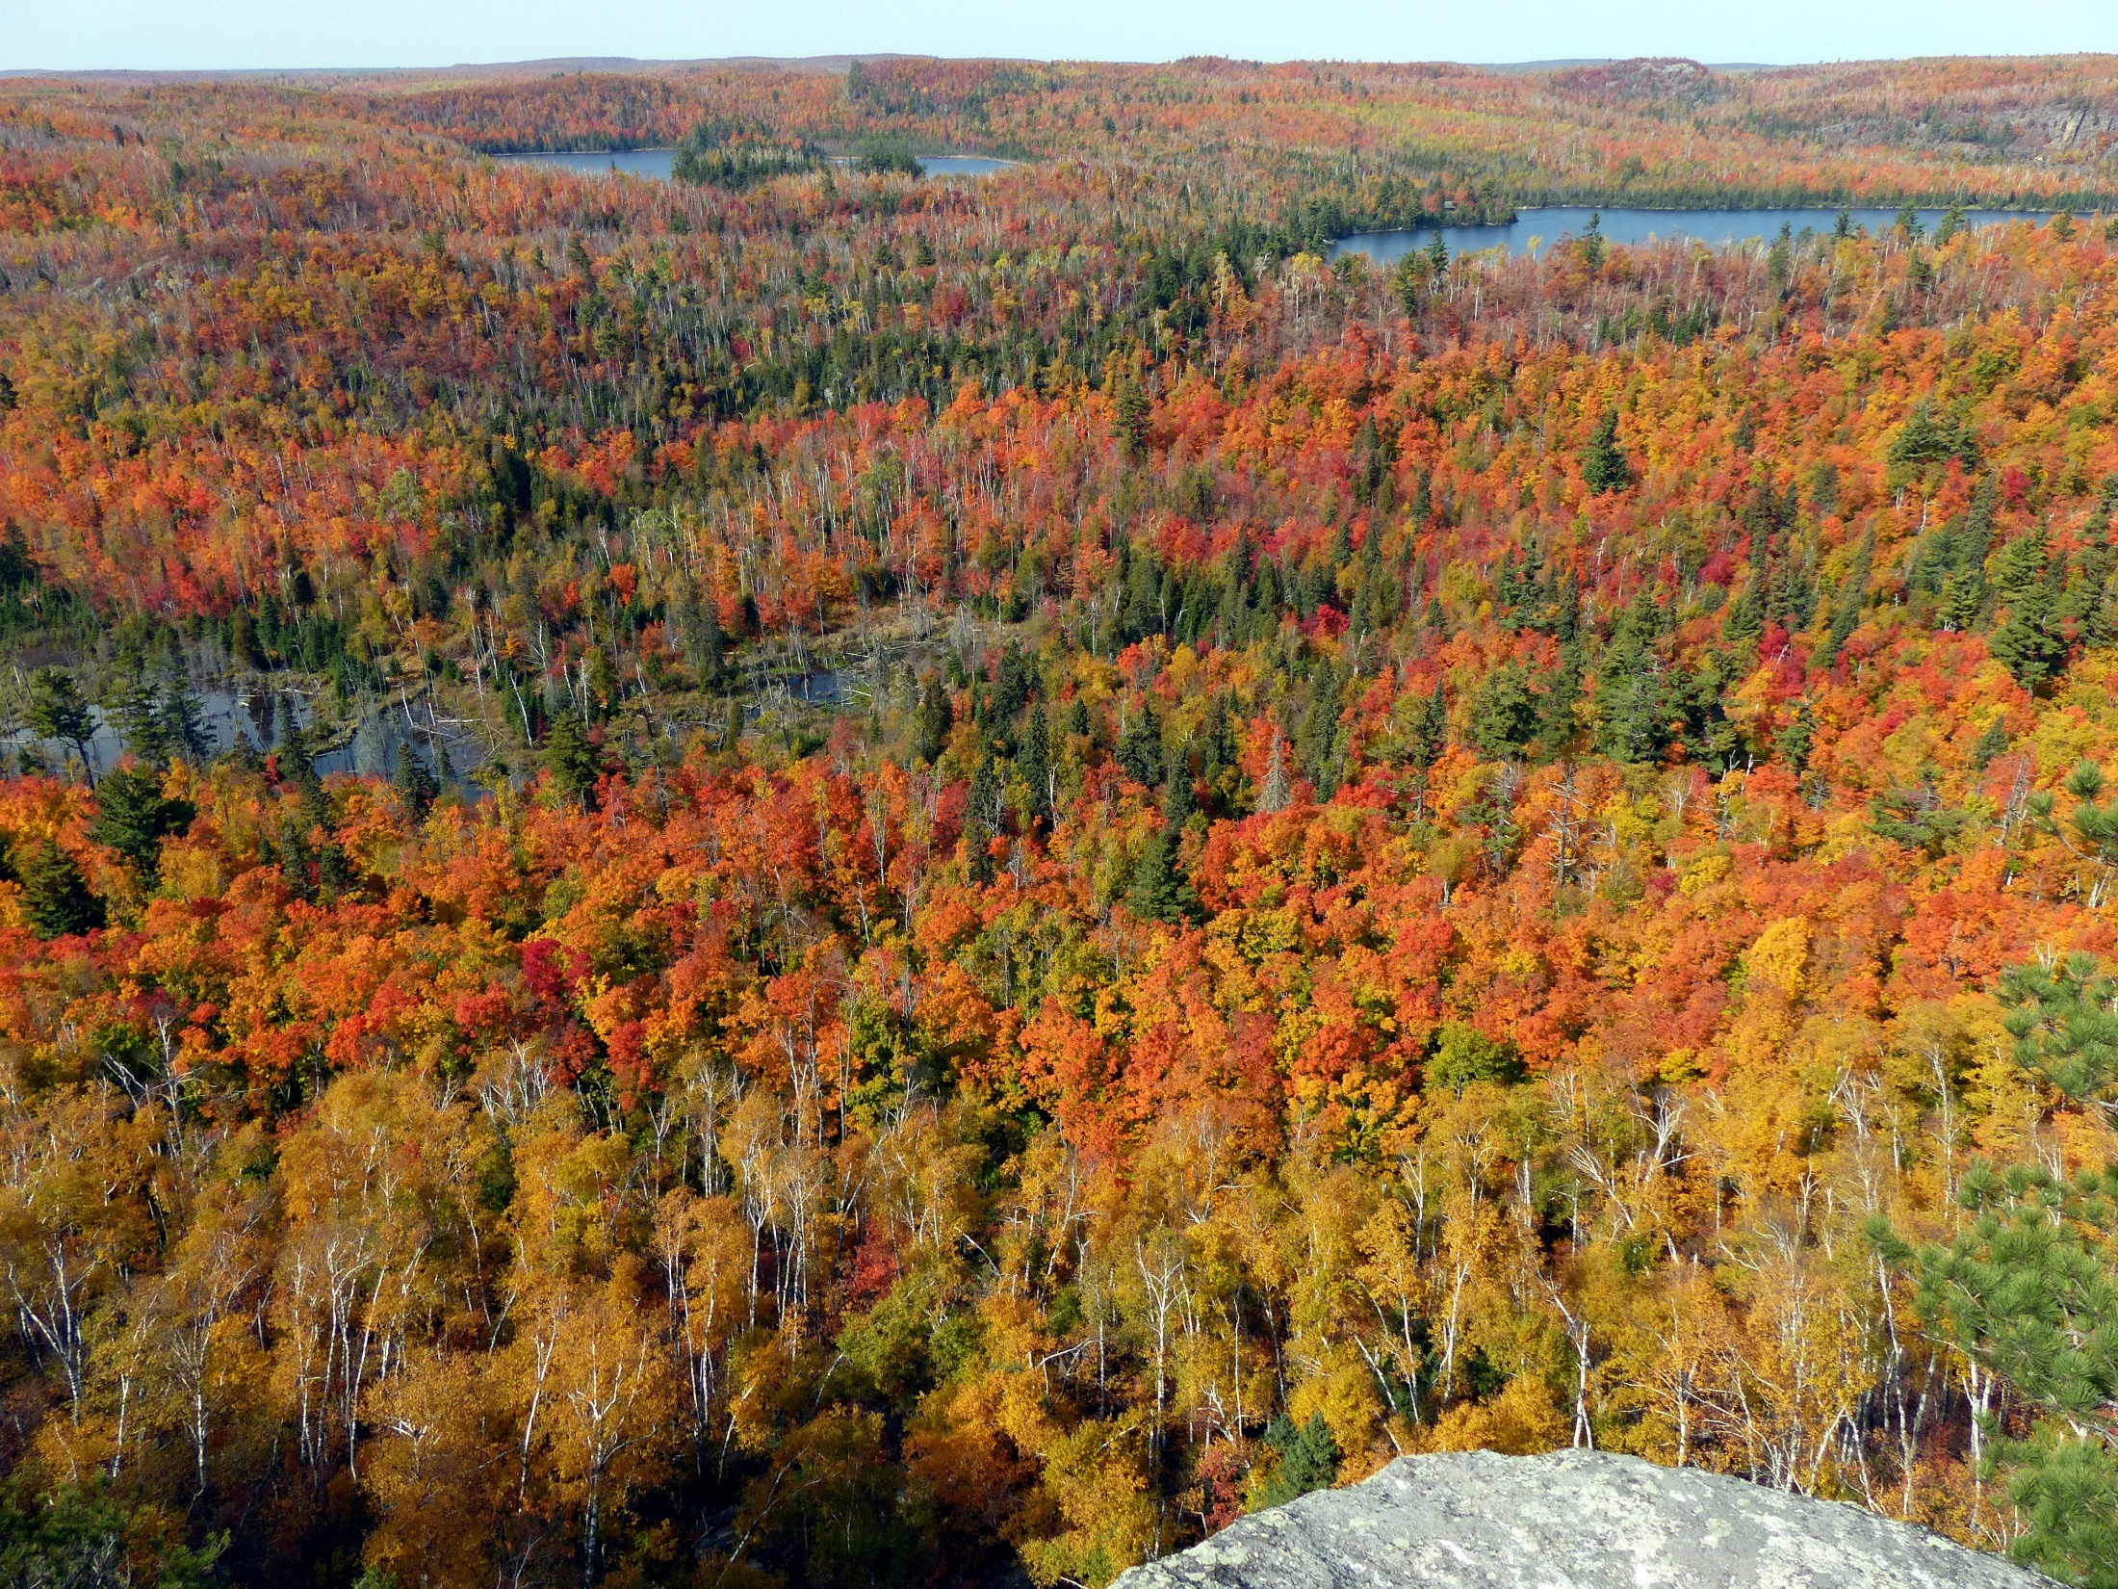

MetroGIS
Coordinating
Committee Meeting
Wednesday, September 16, 2020

Slide 2
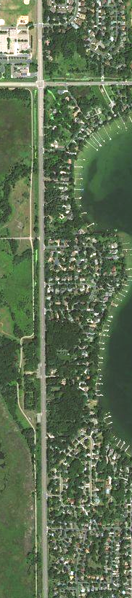

Agenda Item 1:
Call to Order
Agenda Item 2:
Approve Today’s Agenda
Agenda Item 3:
Approve Minutes from 11/14/19

Slide 3
Agenda Item 4:
Update on MetroGIS Coordinator Position

Slide 4
Agenda Item 5:
Election of Chair and Vice Chair

Slide 5
Agenda Item 6:
New CC Members
Pete Wiringa
U Spatial, Education Seat
Jessi Wyatt
Great Plains Institute, Nonprofit Seat

Slide 6
Agenda Item 7:
Metro Conservation Network
Bart Richardson

Slide 7
Agenda Item 8:
Proposal to Change Parcel Collection and Aggregation Workflows
Jon Hoekenga

Slide 8
Agenda Item 9:
Break

Slide 9
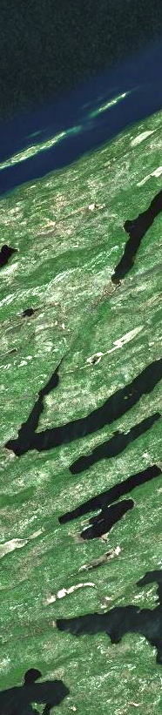
Agenda Item 10
Approval of 2020 (21?) Work Plan

Slide 10
Priorities Matrix

Slide 11
Agenda Item 11
Work Plan Projects

Slide 12
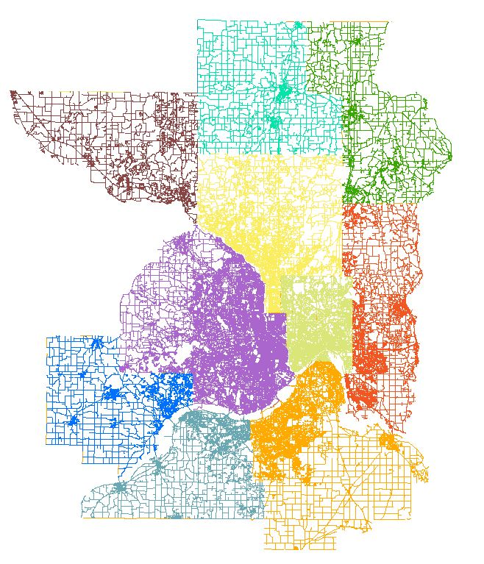
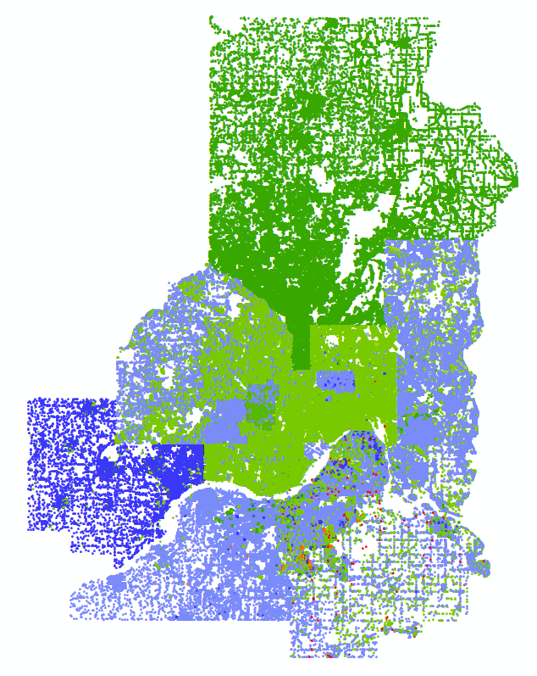
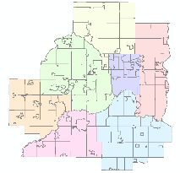
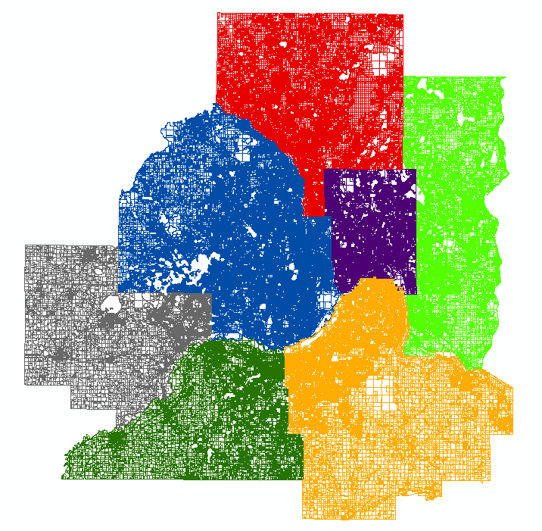
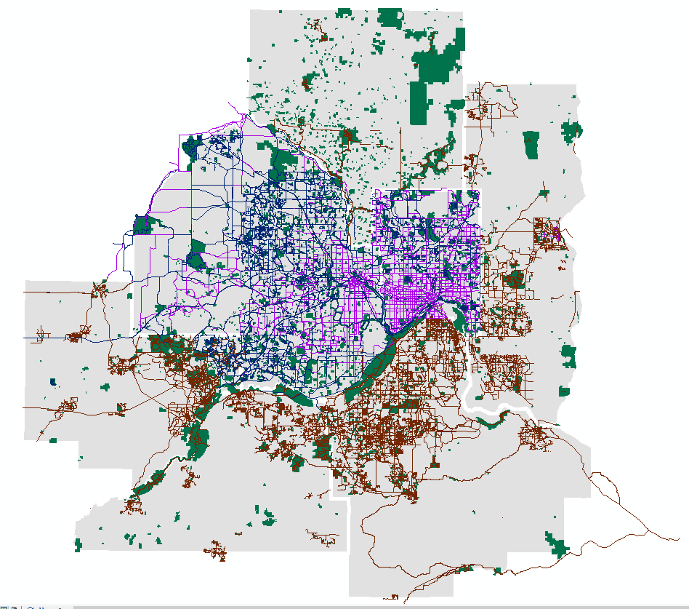
Maintenance of Regional Datasets
Parcels
2002 - present
Roads
2017 - present
Address Points
2018 - present
Parks and Trails
2018 - present

Slide 13
Status Updates
Active & In Progress
Projects

Slide 14
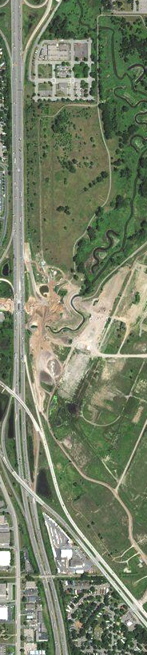

2020 MetroGIS
Current Work Plan Priorities
#1 – Statewide Road Centerlines & Migration to Standard
#2 – Metro Stormwater Geodata Project
#3 – Metro Park and Trail Standard and Data
#4 – 9-1-1 Regional Data Viewer
#5 – Increased Frequency of Regional Parcel Dataset
#6 – External Platform Publishing

Slide 15


Project Priority #2:
Metro Stormwater Geodata Project
Project Overview/Recap:
Document the business needs (2018-19)
Develop a draft standard to meet needs
Draft standard document and
sample dataset for public testing/review
Public review: Apr 17, 2020 – Oct 30, 2020

Slide 16

Project #2:
Metro Stormwater Geodata Project
Outreach:
August 20:
University of Minnesota
Water Resources Center
Stormwater Seminar Series

Slide 17


Project #2:
Metro Stormwater Geodata Project
Outreach (Upcoming)
October 21:
University of Minnesota
Water Resources Conference
October 22:
Central States Water
Environment Association

Slide 18




Project #2:
Metro Stormwater Geodata Project
Public comments are coming in:
>> Supportive & appreciate the detail
>> Tree trenches
>> Green roofs
>> Green infrastructure attributes
>> Asset Management integration
>> Data submittal for meeting permitting requirements
Jon Røstum
Volue/Powel Environment (Oslo, Norway)
Isabel Sifert-Dähnn
Norwegian Institute for Water Research (Oslo, Norway)
Kim Soulliere
City of Golden, Colorado

Slide 19
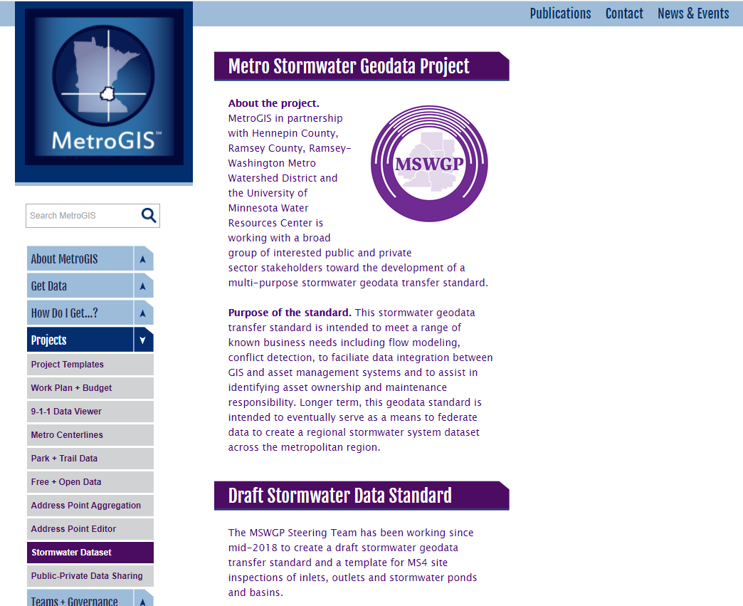

metrogis.org
> Projects
>> Stormwater Dataset

Slide 20

metrogis.org
> Projects
>> Stormwater Dataset
Draft Standard
>> Documents
>> Spreadsheets
Inspection Schema
>> Documents
>> Spreadsheets
Sample Dataset
>> .gdb format
>> .shp format

Slide 21
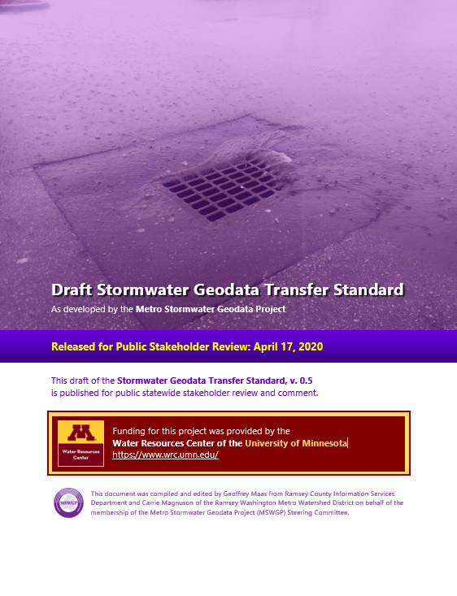
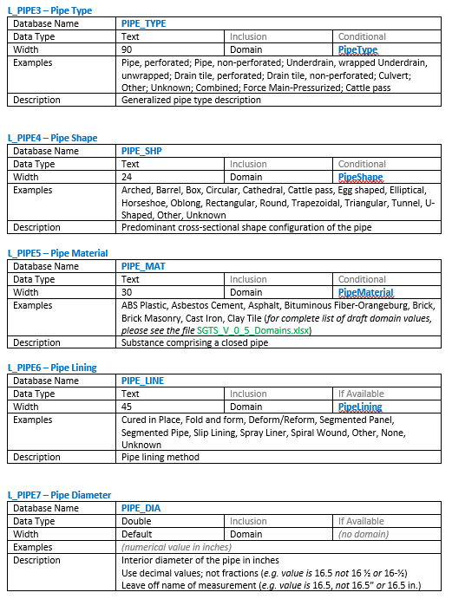
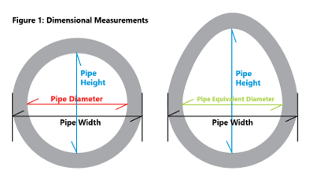
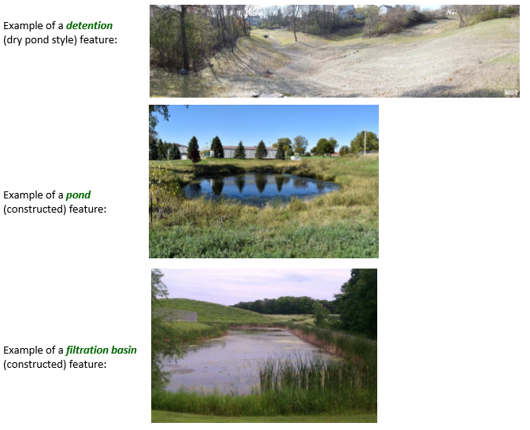
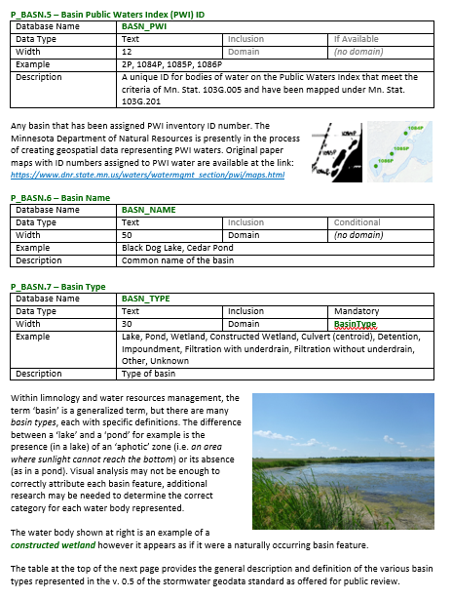
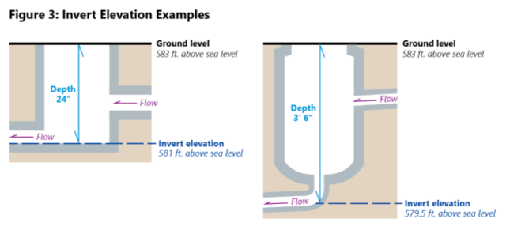

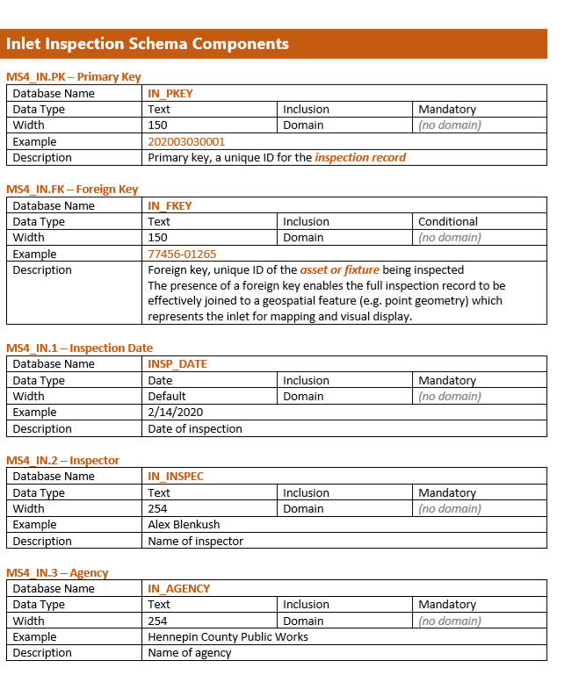
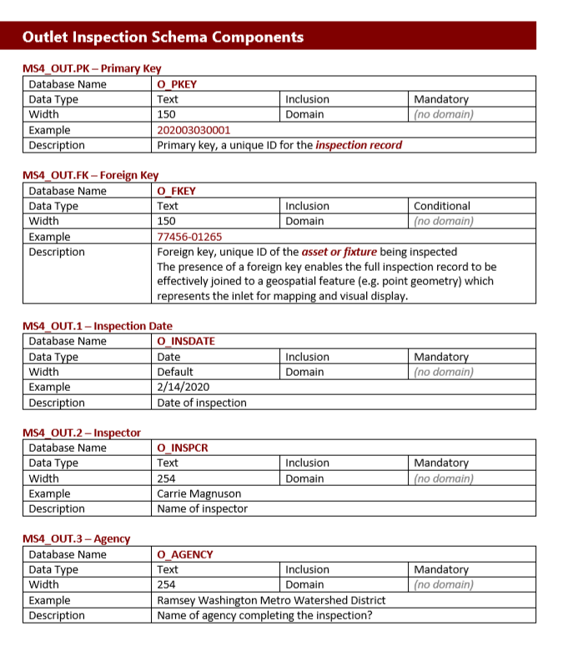
Draft Stormwater Standard
MS4 Pond/Inlet/Outlet Inspection Schema

Slide 22
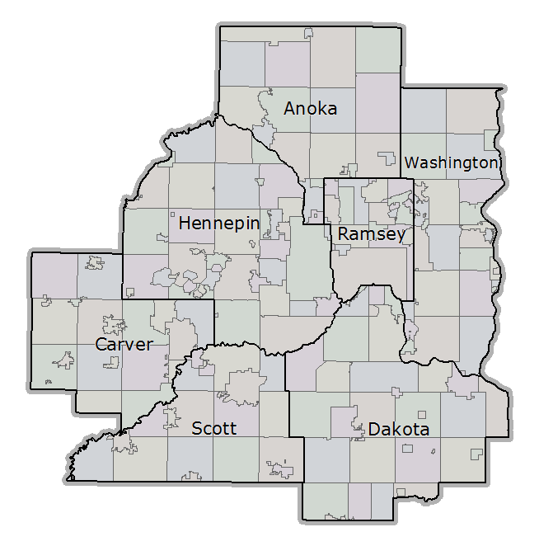
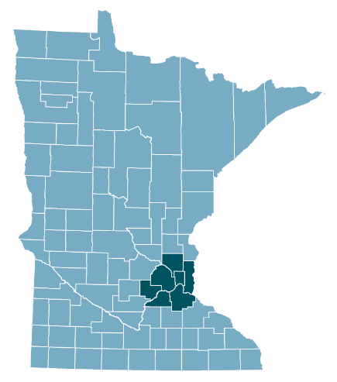
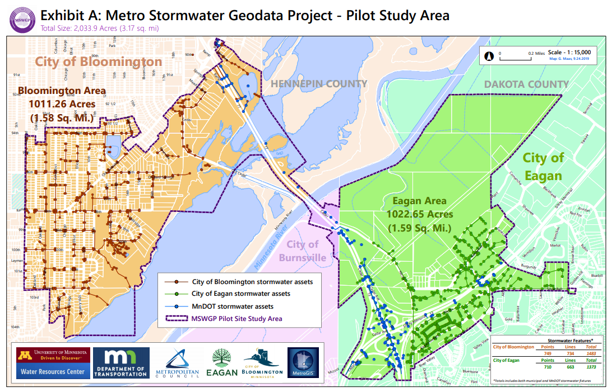

Slide 23
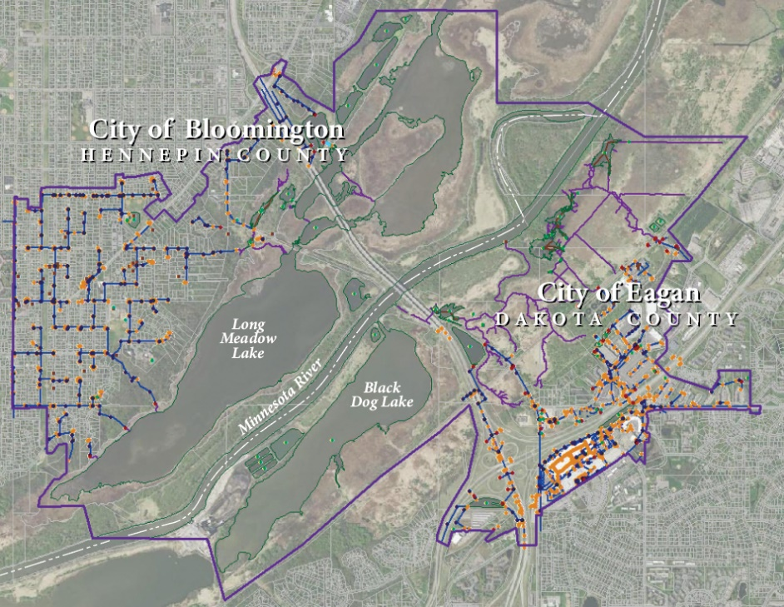

Slide 24
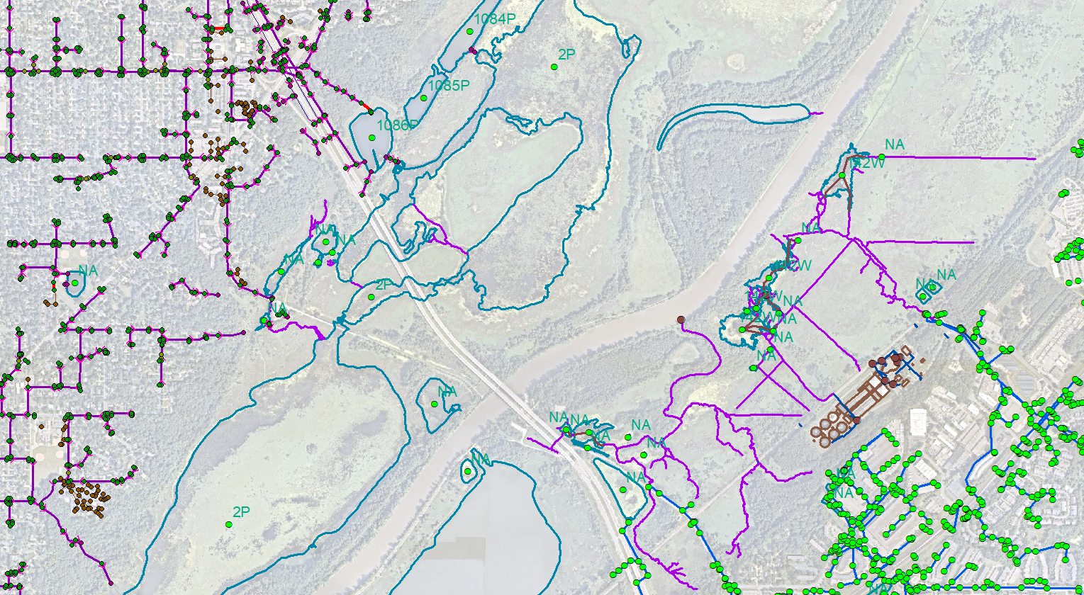
Real data: Two cities, MnDOT
Metropolitan Council

Slide 25
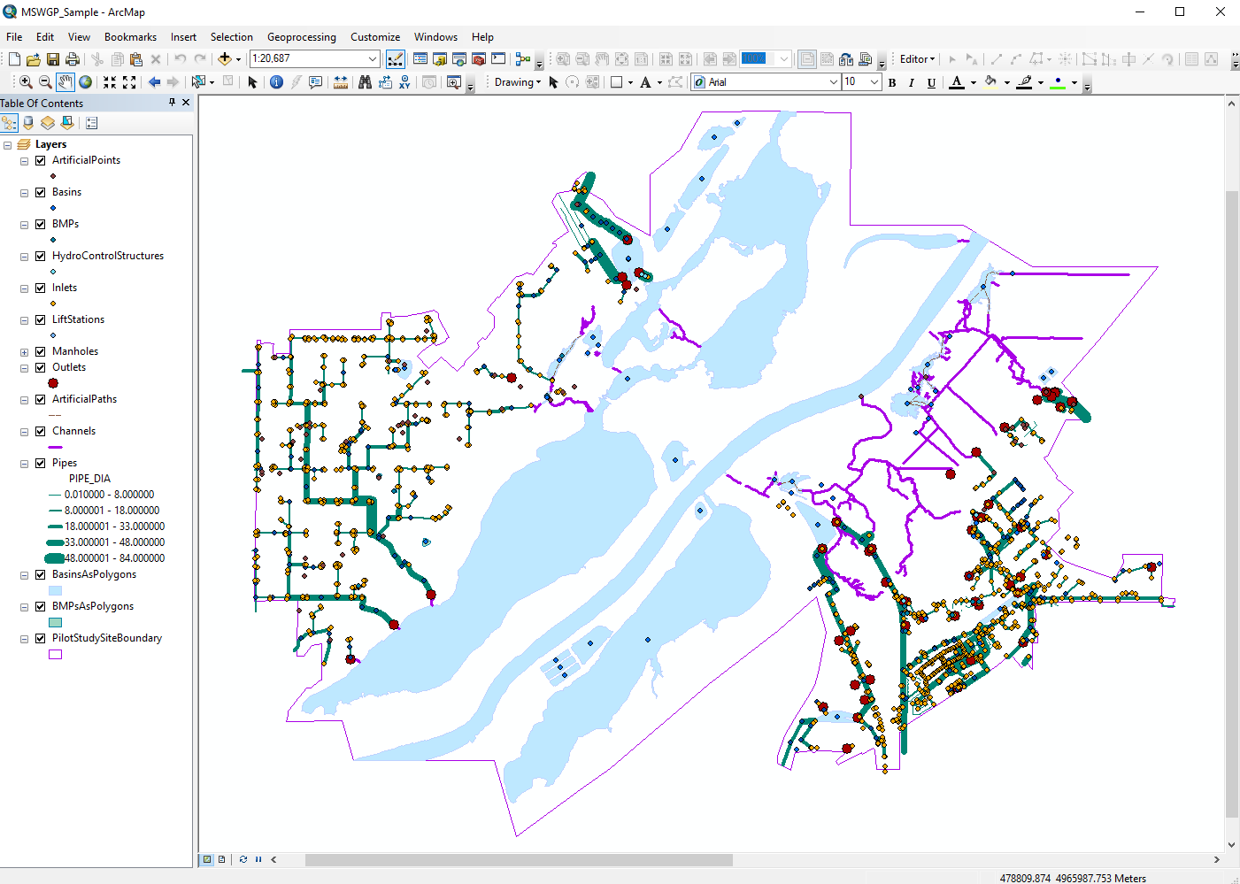

Slide 26

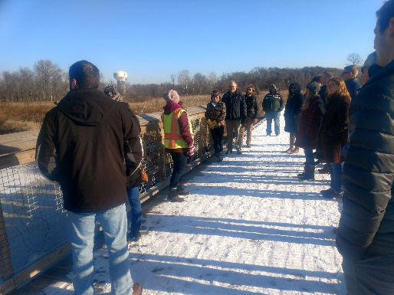
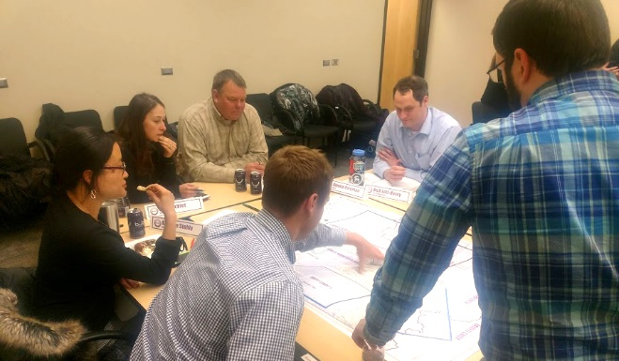
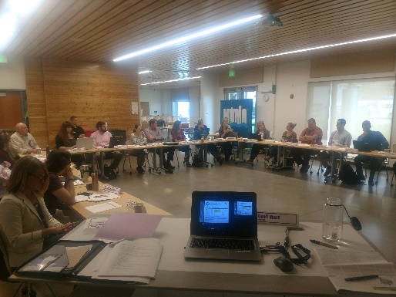
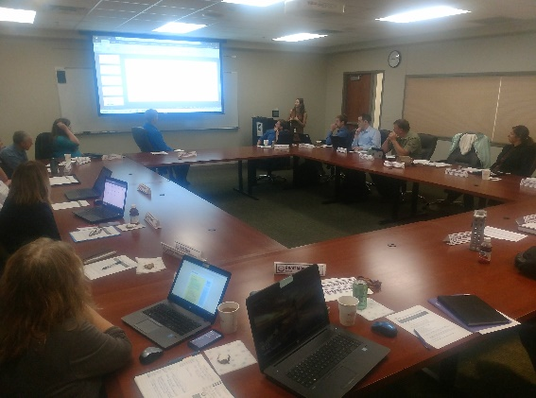
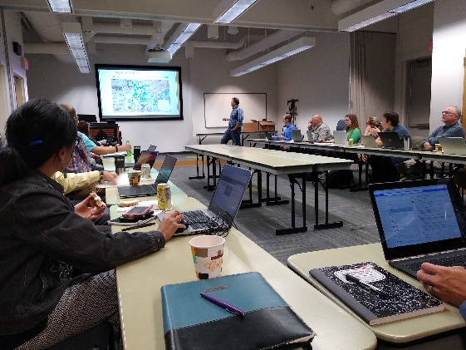
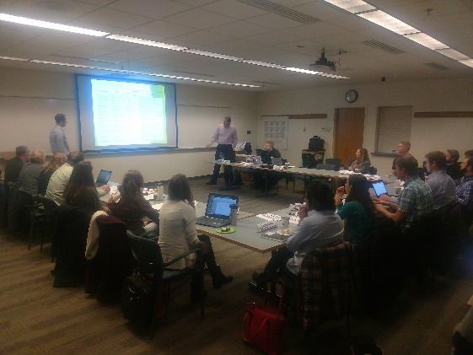
Huge thanks to:
Minnesota Stormwater
Research Council
To all our participating individuals and agencies…

Slide 27
Agenda Item 12:
GAC Updates
Kotz, others

Slide 28

Agenda Item 13
Announcements, etc.

Slide 29

Adjourn

