Slide 1
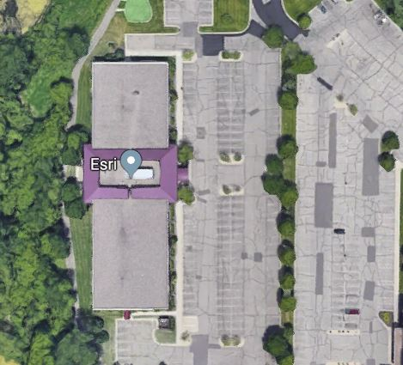
METRO STORMWATER
GEODATA PROJECT
Steering Team Meeting #5
Tuesday, April 30, 2019
esri – Eagan Office
800 Blue Gentian Road
Suite 200
Eagan, MN 55121

Slide 2
“The world is run by those who show up…”

Slide 3
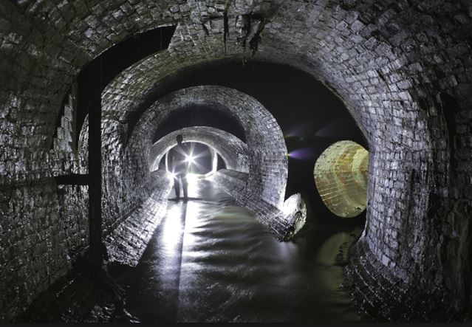
1 ) Welcome & Introductions
2 ) Quick MSWGP Project Updates

Slide 4
Quick MSWGP Project Updates
Outreach: Since 2/26/2019
Outreach to MnDOT
>> Met with MnDOT staff: 2/27/19
>> “GIS Bytes” (statewide webinar) 3/19/19
Association of Metropolitan Municipalities
>> Executive Team 3/21/19
MetroGIS Policy Board
>> Annual in-person meeting 4/24/19

Slide 5
Quick MSWGP Project Updates
Upcoming outreach
MN Pollution Control Agency
>> Staff and leadership 5/23/19
MN Geospatial Advisory Council
>> Update to geospatial community 5/29/19
U of M: Water Resources Center
>> Report to grant funders 6/??/2019

Slide 6
Quick MSWGP Project Updates
Upcoming outreach
Board of Metro Chapter-MAWD
>> Update to leadership (St. Paul) 7/16/19
MAWD State Conference
>> Annual conference (Alexandria) 12/5/19
Looking to present in the future to:
League of Minnesota Cities
MN Society of Professional Engineers
MN 2050 Project + other stakeholder organizations

Slide 7
Quick MSWGP Project Updates
Responses so far:
>> Favorable & supportive;
>> People providing their contact info to take part during the review and stakeholder input opportunities

Slide 8
Quick MSWGP Project Updates
Internal MSGWP team effort
Point/Polygon Team (In-person meeting, Minneapolis)
>> Discussion and revisions 3/26/19
Line/Routing Team (Conference call)
>> Discussion and minor revisions 4/2/19
Asset Management (In-person meeting, Medina)
>> Discussion, revisions, etc. 4/10/19

Slide 9
Metro Stormwater Geodata Project
Peter L. Croswell
The GIS Management Handbook
Forthcoming
2nd Edition to cite
and utilize our
MSWGP Project Charter
as an good example of
inter-agency project scoping and documentation

Slide 10
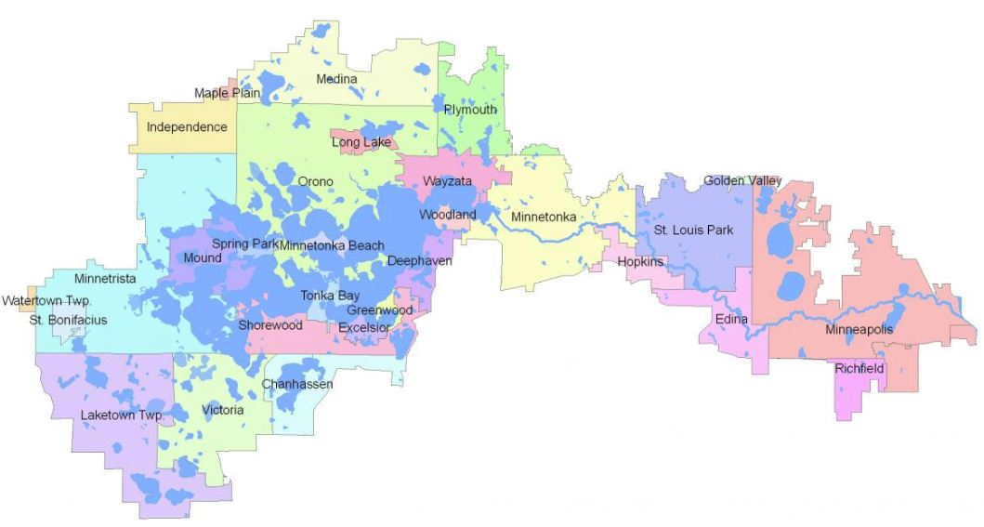
Metro Stormwater Geodata Project
Minnehaha Creek Watershed District Example
For agencies that need inter-jurisdictional stormwater data, it provides a standard to translate data into;

Slide 11
“Taking the pulse” of the project

Slide 12
“Taking the pulse” of the project
Survey Monkey comments:
>> Participant feedback (come in prepared)
>> Fuller understanding of the wide range of business needs to be met by the standard and the data
>> The marginalizing of lesser (but important) needs
>> Stronger leveraging of existing resources
ESRI Local Government Info Model
Other standards (State DOTs, large cities schemas)

Slide 13
“Taking the pulse” of the project
At our Summit on April 17, 2018 in Medina:
Project Steering Team to convene:
“4 to 6 meetings over 12 to 18 months”
6/28/18: MWMO, Minneapolis
8/26/18: CCWMO, Chaska
11/14/18: City of Blaine
2/26/19: City of Maple Grove
4/30/19: ESRI, Eagan

Slide 14
“Taking the pulse” of the project
6/28/18: MWMO, Minneapolis
8/26/18: CCWMO, Chaska
11/14/18: City of Blaine
2/26/19: City of Maple Grove
4/30/19: ESRI, Eagan
7/XX/19: City of Bloomington

Slide 15
“Taking the pulse” of the project
May-July 2019: Small group work
July 2019: Meeting #6 in Bloomington
Summer 2019: Small group work (as needed)
Pilot project data collection
Email updates/communication
Draft ready by August 9th
Late 2019: Convene in person to review progress on pilot

Slide 16
Agenda Item 3:
Pilot Project Data Collection
Update

Slide 17
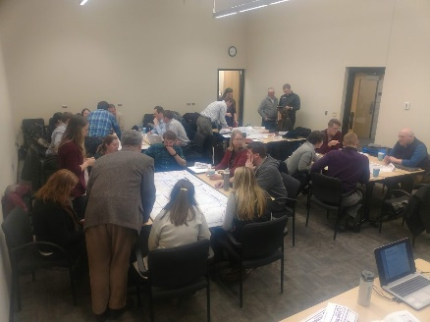
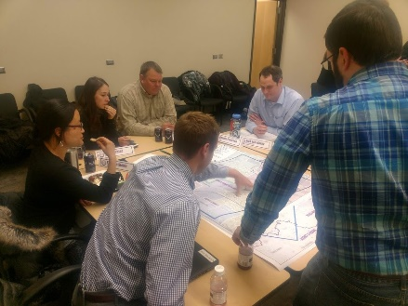
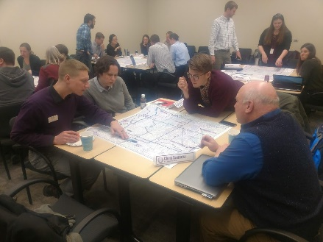
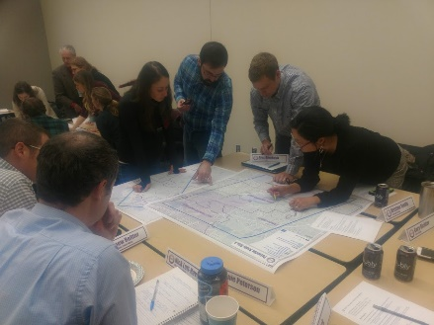
Metro Stormwater Geodata Project

Slide 18
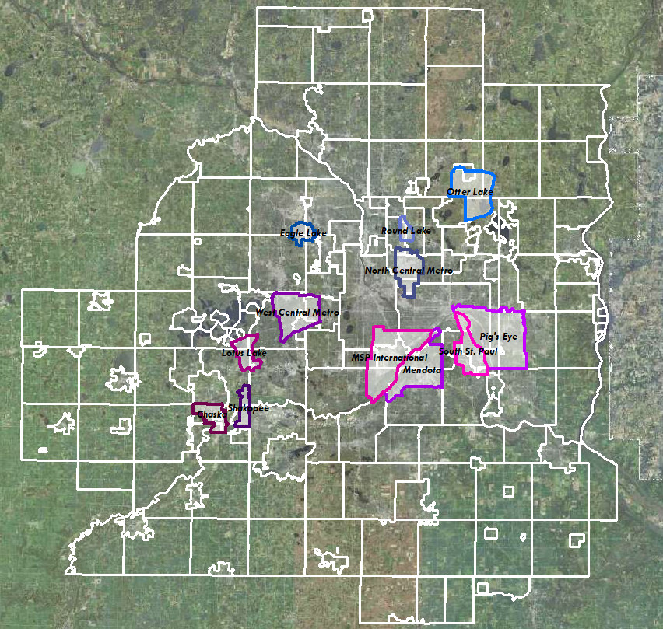
Metro Stormwater Geodata Project

Slide 19
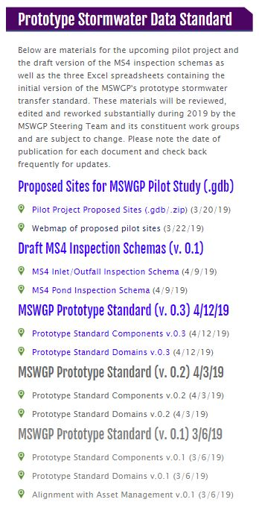
Metro Stormwater Geodata Project

Slide 20
Metro Stormwater Geodata Project
Geodata “bass”

Slide 21
Metro Stormwater Geodata Project
.gdb

Slide 22
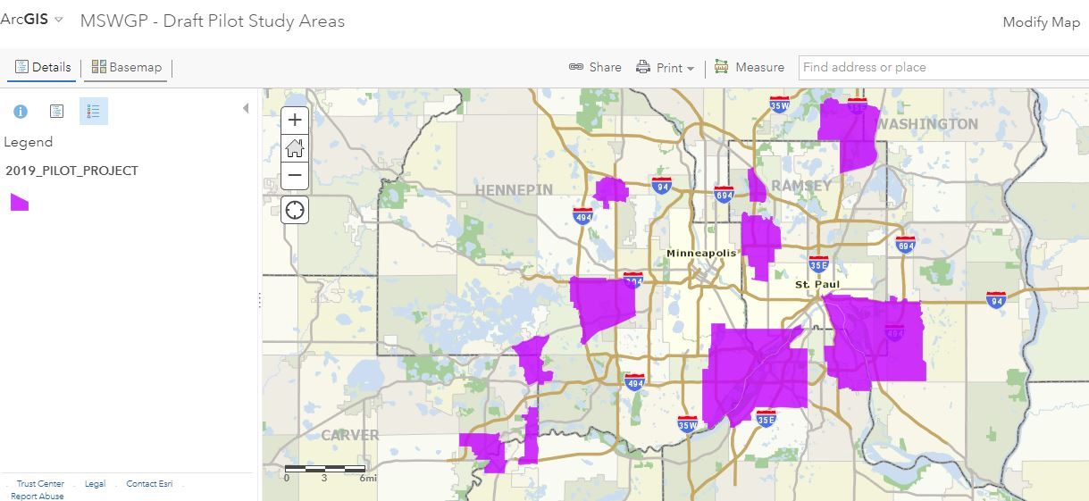
Metro Stormwater Geodata Project
.gdb

Slide 23
Metro Stormwater Geodata Project
.gdb

Slide 24
Metro Stormwater Geodata Project
.gdb
$8000

Slide 25
Agenda Item 3:
Pilot Project Data Collection
May 2019
We will be reaching out to agencies and interests that have stormwater fixtures and assets in our selected pilot areas…

Slide 26
Agenda Item 3:
Pilot Project Data Collection
May 2019
We will be reaching out to agencies and interests that have stormwater fixtures and assets in our selected pilot areas…
>> Contact/letter/email/call
>> Detailed map of their area
>> Overview of the what and why of the request

Slide 27
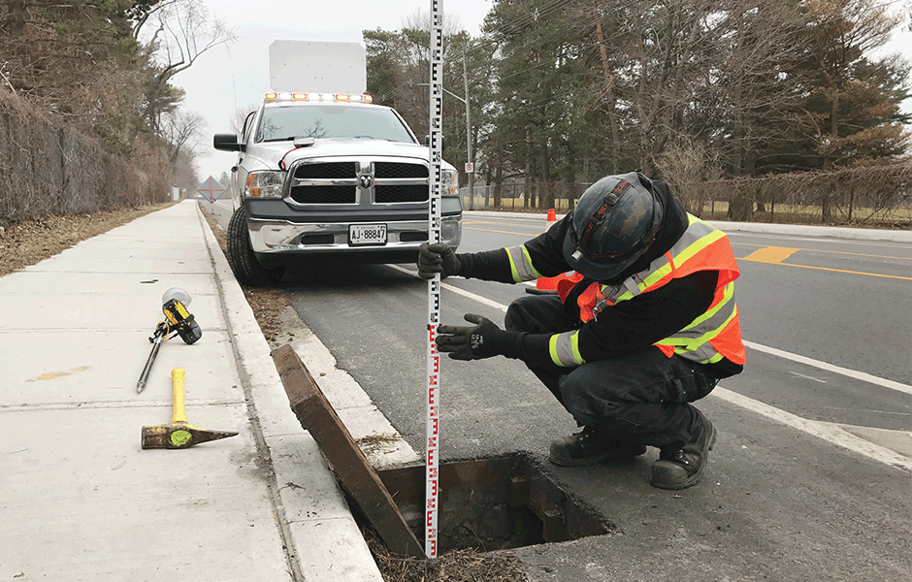
Agenda Item 3:
Pilot Project Data Collection
Summer 2019
Assess the quality and completeness of the data we receive
Translate it into
our prototype standard
Field check what areas we can for completeness

Slide 28
Agenda Item 3:
Pilot Project Data Collection
Summer 2019
Assess the quality and completeness of the data we receive
Translate it into
our prototype standard
Field check what areas we can for completeness

Slide 29
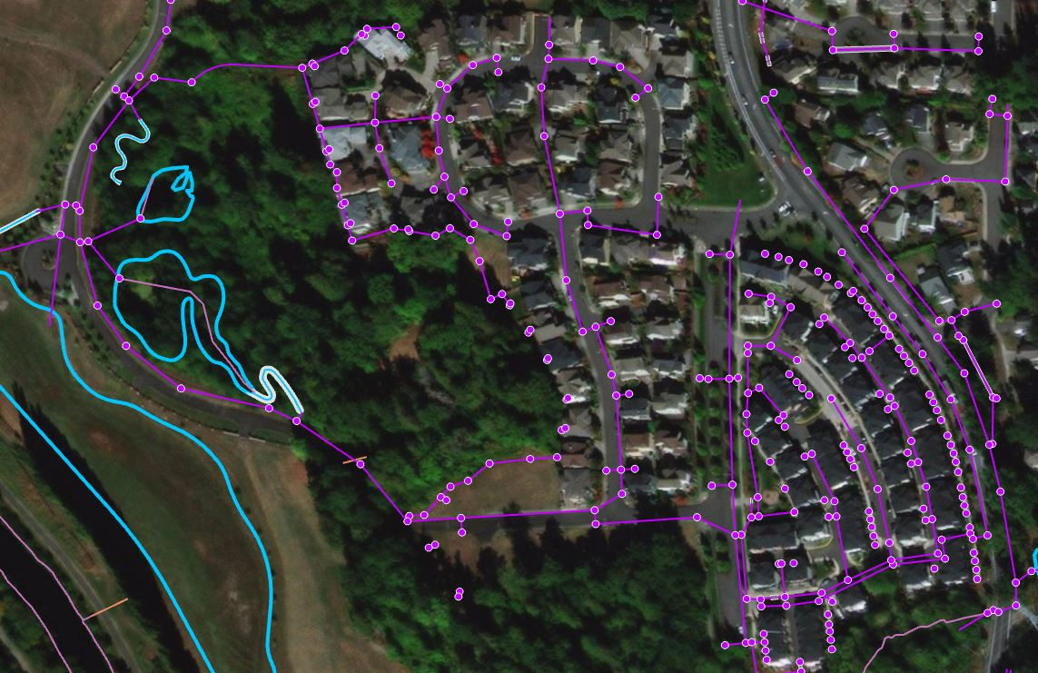
Agenda Item 3:
Pilot Project Data Collection
Fall 2019
Have a sample
(or set of samples) ready to distribute to the stakeholder community…
>> Begin Review
>> Continue Outreach
>> Policy research

Slide 30
Agenda Item 3:
Pilot Project Data Collection
Winter 2019-20
Document, review
& respond to the incoming stakeholder input
MSWGP will review and recalibrate our standard based on the input we receive

Slide 31
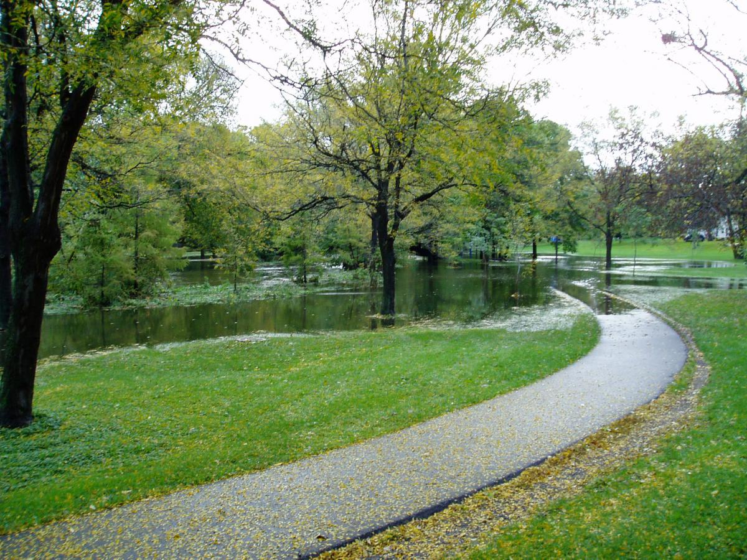
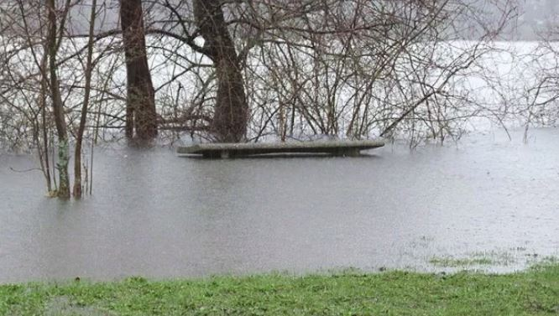
Agenda Item 3:
Pilot Project Data Collection
Spring 2020
>> Modify & revise
>> Continue outreach
>> 2nd Stage Pilot Project
>> Advance standard

Slide 32
Agenda Item 3:
Pilot Project Data Collection
We are creating materials (our prototype standard and our sample data)…

Slide 33
Agenda Item 3:
Pilot Project Data Collection
We are creating materials (our prototype standard and our sample data)…
that will facilitate input, comment and intelligence gathering from the broader stakeholder, data producer and
data consumer community….

Slide 34
Agenda Item 3:
Pilot Project Data Collection
We are creating materials (our prototype standard and our sample data)…
that will facilitate input, comment and intelligence gathering from the broader stakeholder, data producer and
data consumer community….
..which will result in a standard that folks will want to actually use : )

Slide 35
Agenda Item 4:
Terminology, Glossary and Related Supporting Resources
Needed

Slide 36
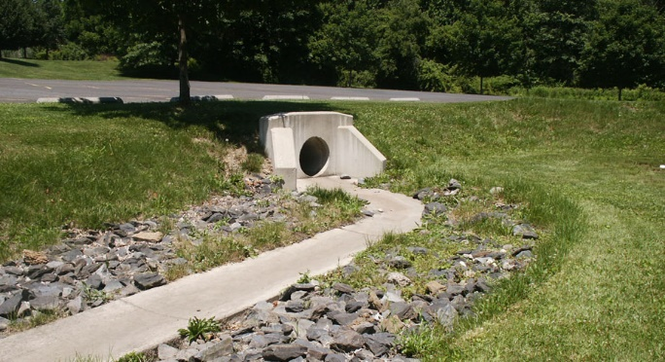
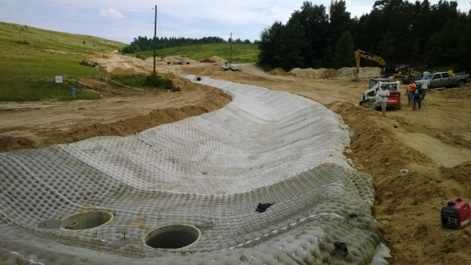
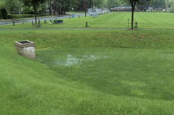
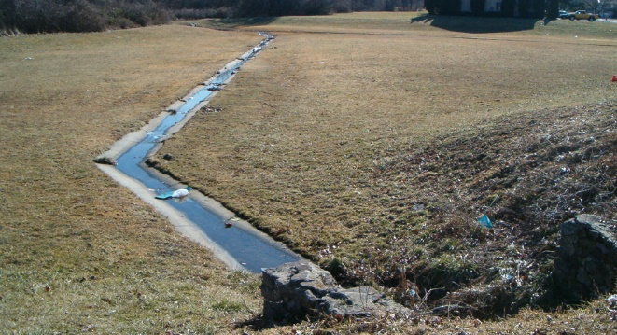
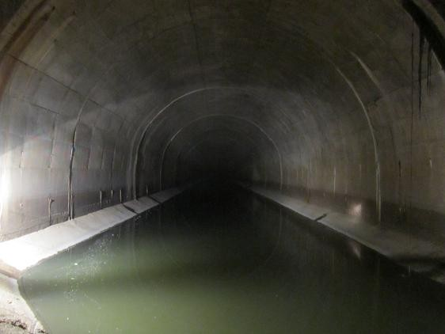
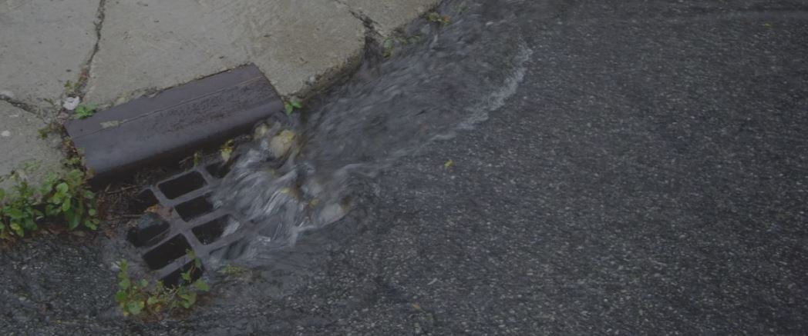
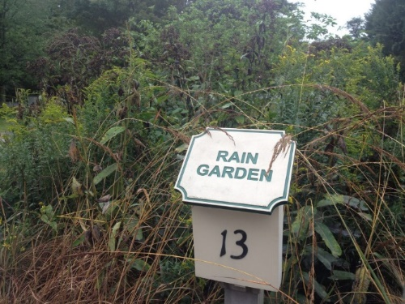
Agenda Item 4:
Terminology, Glossary and Related Supporting Resources Needed

Slide 37
Agenda Item 4:
Terminology, Glossary and Related Supporting Resources Needed
Consistent terminology for all the natural & constructed ‘stuff’ we are trying to capture and represent
Use those terms in our
transfer standard…
Cross-walk those to the supporting documentation
We’re really gonna need:
Engineers
Asset Management
Water Quality Professionals
Inspection Experts

Slide 38
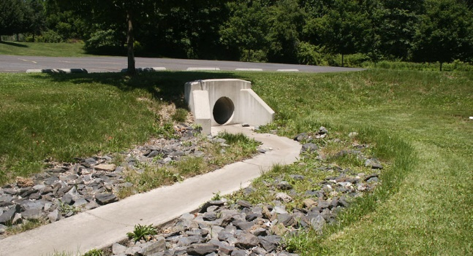
Agenda Item 4:
Terminology, Glossary and Related Supporting Resources Needed
Why?
Facilitates the ease and clarity of usage and communication
Most GIS-specific people know
little (or nothing) about the specifics of stormwater systems;
Enhances use by architects, landscape architects, GIS, non-technical lay people

Slide 39
Agenda Item 4:
Terminology, Glossary and Related Supporting Resources Needed
We don’t have to start from scratch…

Slide 40
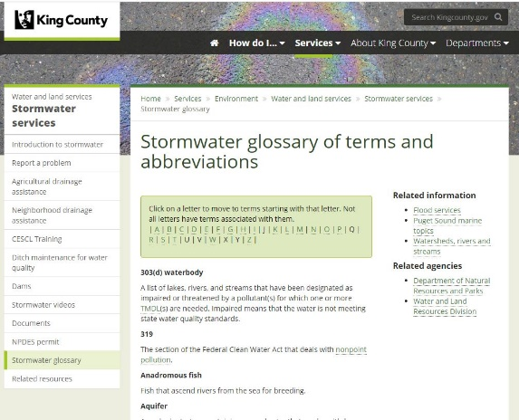
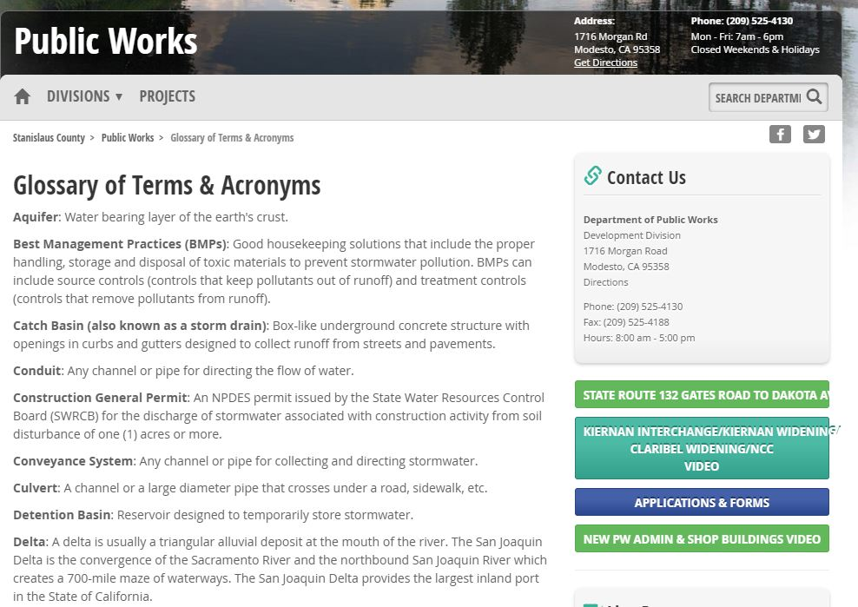
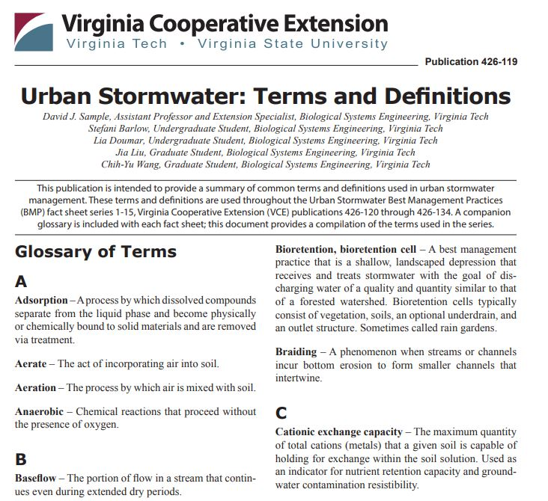
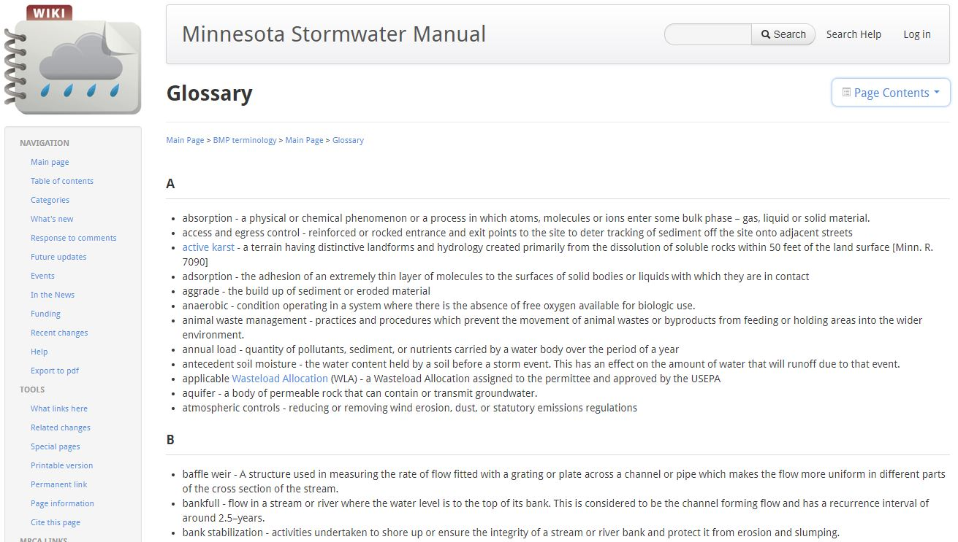
Agenda Item 4:
Terminology, Glossary and Related Supporting Resources Needed
We don’t have to start from scratch…
…lots of resources to draw from

Slide 41
Agenda Item 4:
Terminology, Glossary and Related Supporting Resources Needed
We don’t have to start from scratch…
Applicable parts of:
MN Statutes §103A-H & §115
MN Administrative Rules
…lots of resources to draw from

Slide 42
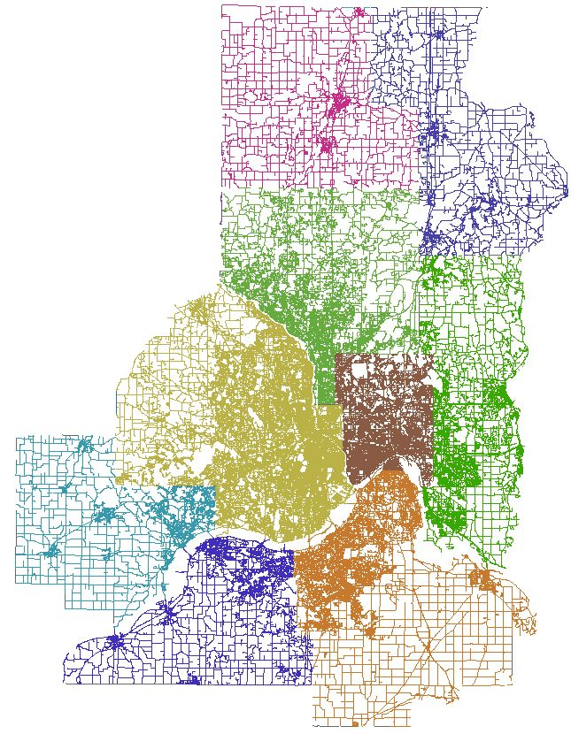
Metro Regional
Road Centerlines
Originally just the
7 metro counties

Slide 43
Metro Regional
Road Centerlines
Originally just the
7 metro counties
2018 added Chisago Co.
2019 added Isanti Co.
Working to add
Sherburne Co.
>> NG9-1-1
>> Routing
>> Geocoding
>> Many others

Slide 44
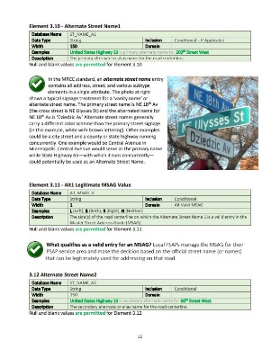
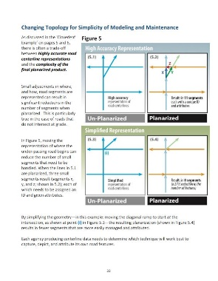
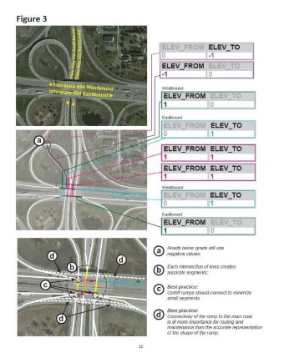
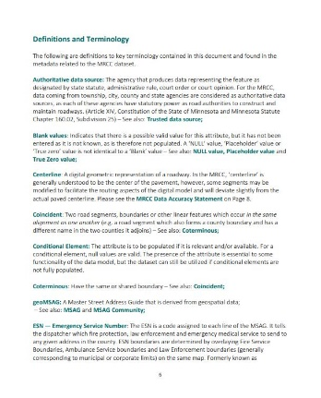
Metro Regional Road Centerlines
Best Practices Guide completed May 2018
44 pages
>> Examples
>> Graphics
>> Guidance
>> Terminology

Slide 45
Metro Regional Road Centerlines
Best Practices Guide completed May 2018
Documents are a tool that helps
both the data producers and the data consumers work efficiently;
Facilitates consistency of data creation, delivery and usage.
Removes ambiguity
Source from which to resolve disagreements

Slide 46
Metro Regional Road Centerlines
Hey kid…you want
some road data…?

Slide 47
Agenda Item 4:
Terminology, Glossary and Related Supporting Resources Needed
What we’ll need:
>> Engineering Expertise
>> Asset Management Expertise
>> Water Quality Expertise
>> Geospatial Expertise
>> Editor/Compiler/Documentarian

Slide 48
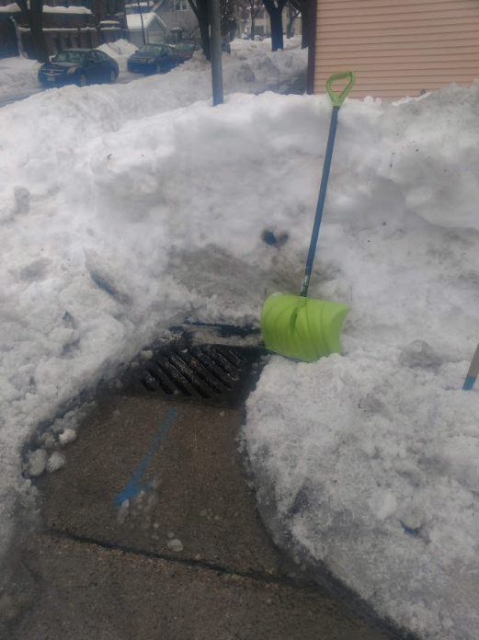
It’s March in Minnesota…
Do you know where
your storm drain is?

Slide 49
Agenda Item 5:
Prototype Standard
“Step-Through”

Slide 50
Purpose of the ‘Step-Through’:
Put things in one of three ‘buckets’

Slide 51
Purpose of the ‘Step-Through’:
Put things in one of three ‘buckets’
‘Go Ahead’ “We’ve blessed it, let’s test it”
‘Let’s Talk’ Tap into shape today
‘Needs Work’ Needs more detailed
discussion & attention

Slide 52
Ok, let’s dive in…

Slide 53
Ok, let’s dive in…
Keep in mind:
We don’t have to be perfect, we simply have to have something good enough to put out for stakeholder review and comment
Ok, let’s dive in…
Keep in mind:
We don’t have to be perfect, we simply have to have something good enough to put out for stakeholder review and comment

Slide 54
Ok, let’s dive in…
Disclaimer: Any and all errors, omissions, misinterpretations and misspellings are Geoff’s fault and will be corrected on the next go-around
Disclaimer: Any and all errors, omissions, misinterpretations and misspellings are Geoff’s fault and will be corrected on the next go-around
(thank you for your patience…)

Slide 55
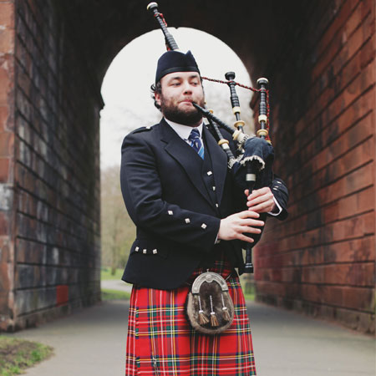
Let’s start with Pipes

Slide 56
Let’s start with Pipes
Not those pipes…
…these pipes:
L_PIPES

Slide 57
L_PIPES
Pipe ID
Pipe Federated ID
Pipe Type
Pipe Shape
Pipe Material
Pipe Lining

Slide 58
L_PIPES
Pipe ID
Pipe Federated ID
Pipe Type
Pipe Shape
Pipe Material
Pipe Lining
We have created
domains for these

Slide 59
Pipe Type Domain
Code | Value
Pipe, perforated | Pipe, perforated
Pipe, non-perforated | Pipe, non-perforated
Underdrain, wrapped | Underdrain, wrapped
Underdrain, unwrapped | Underdrain, unwrapped
Drain tile, perforated | Drain tile, perforated
Drain tile, non-perforated | Drain tile, non-perforated
Culvert | Culvert
Other | Other
Unknown | Unknown
Combined | Combined
Force Main | Force Main
Pressurized Pipe | Pressurized Pipe
Gravity Pipe | Gravity Pipe
Cattle pass | Cattle pass

Slide 60
Pipe Shape - Domain
Code | Value
Arched | Arched
Barrel | Barrel
Box | Box
Circular | Circular
Cathedral | Cathedral
Cattle pass | Cattle pass
Egg shaped | Egg shaped
Elliptical | Elliptical
Horseshoe | Horseshoe
Oblong | Oblong
Rectangular | Rectangular
Round | Round
Trapezoidal | Trapezoidal
Triangular | Triangular
Tunnel | Tunnel
U-Shaped | U-Shaped
Other | Other
Unknown | Unknown

Slide 61
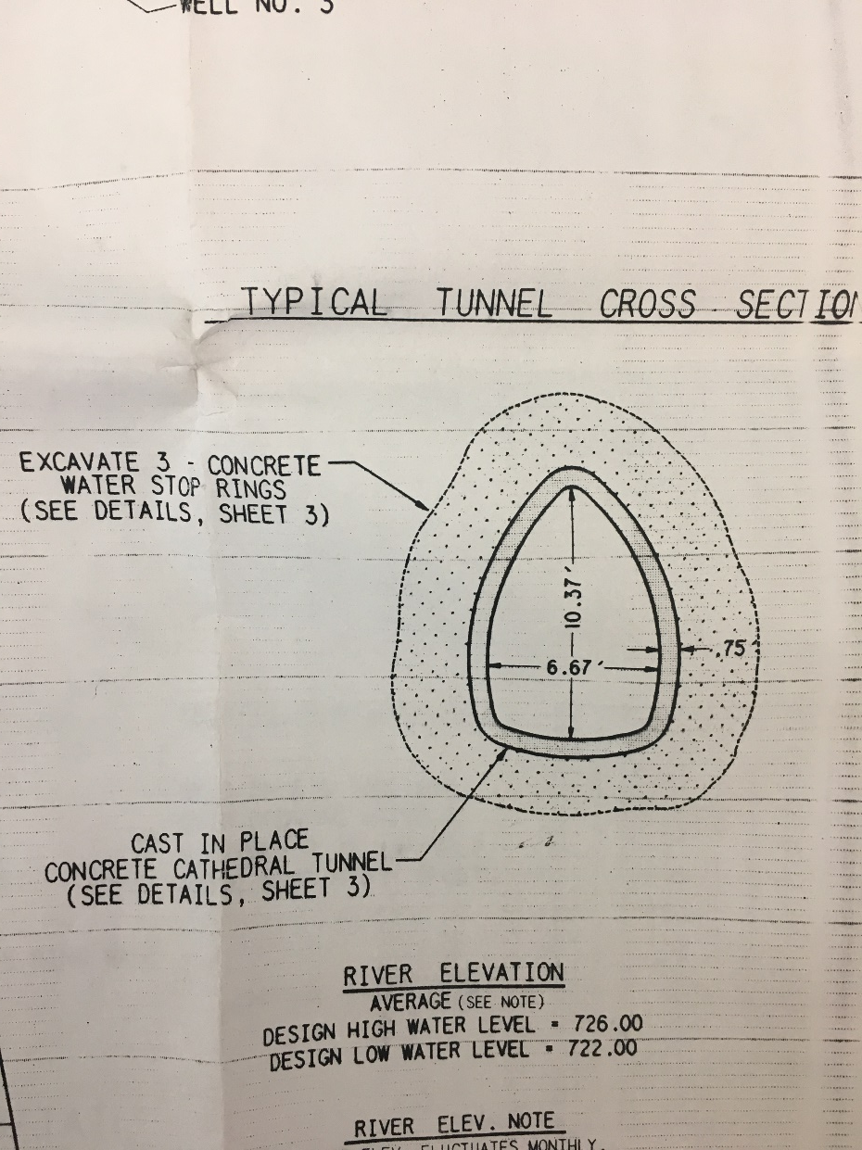
Pipe Shape
Code | Value
Arched | Arched
Barrel | Barrel
Box | Box
Circular | Circular
Cathedral | Cathedral
Cattle pass | Cattle pass
Egg shaped | Egg shaped
Elliptical | Elliptical
Horseshoe | Horseshoe
Oblong | Oblong
Rectangular | Rectangular
Round | Round
Trapezoidal | Trapezoidal
Triangular | Triangular
Tunnel | Tunnel
U-Shaped | U-Shaped
Other | Other
Unknown | Unknown

Slide 62
Pipe Shape
Code | Value
Arched | Arched
Barrel | Barrel
Box | Box
Circular | Circular
Cathedral | Cathedral
Cattle pass | Cattle pass
Egg shaped | Egg shaped
Elliptical | Elliptical
Horseshoe | Horseshoe
Oblong | Oblong
Rectangular | Rectangular
Round | Round
Trapezoidal | Trapezoidal
Triangular | Triangular
Tunnel | Tunnel
U-Shaped | U-Shaped
Other | Other
Unknown | Unknown
KÖNKRETE KÄTHEÐRÄL TÜNNEL

Slide 63
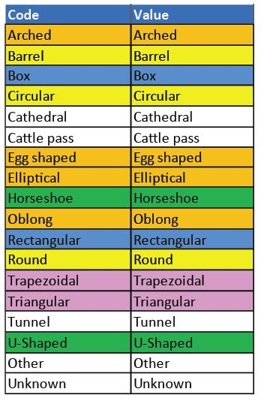
Pipe Shape - Domain
Is there value in
consolidating these into fewer categories, or keep the existing descriptions we have?

Slide 64
Pipe Material – Domain values
ABS Plastic
Asbestos Cement
Asphalt
Bituminous Fiber (Orangeburg)
Brick
Brick Masonry
Cast Iron
Clay Tile
Combination-Multiple Materials
Composite
Concrete, Non-Reinforced
Concrete Segments, Bolted
Concrete Segments, Unbolted
Corrugated Metal
Copper
Cured In Place
Ductile Iron
Fiberglass Reinforced
Earth & Geotextile
Earthen
Geotextile
Galvanized Pipe
Glass Reinforced Cement
High Density Polyethylene
Plastic
Plastic/Steel Composite
Polyethylene
Polypropylene
Polyvinyl Chloride
Pre-Stressed Concrete Cylinder
Reinforced Concrete
Reinforced Plastic, Truss
Segmented Block
Steel
Transite
Vitrified Clay
Wood
Other
Unknown

Slide 65
Pipe Lining - Domain
Cured in Place
Fold and Form
Deform/Reform
Segmented Panel
Segmented Pipe
Spray Liner
Spiral Wound
Other
None
Unknown
Slip Lining

Slide 66
L_PIPES
Pipe Diameter (inches)
Pipe Equivalent Diameter (inches)
Pipe Height (inches)
Pipe Width (inches)
Pipe Length (feet)
Pipe Depth (feet)
Pipe Coverage (definition/domain needed)
(soil, concrete, asphalt, unknown, etc.)

Slide 67
L_PIPES
Pipe Upstream Invert Elevation
Pipe Downstream Invert Elevation
Pipe From (ID of the from asset)
Pipe To (ID of the to asset)
Pipe Casing (Yes, No, Unknown)
Pipe Pressurized (Yes, No, Unknown)

Slide 68
Pipe Status – Domain Values
Code/Value
Active
Inactive
Removed
Proposed
Abandoned
Other
Unknown

Slide 69
Pipe Condition – Domain Values
Code/Value
Excellent
Very Good
Good
Fair
Needs Maintenance
Poor
Very Poor
Non-functioning
Failed
Under construction
Unknown
Too subjective…
Better method?
Less categories?
Numerical rating?

Slide 70
L_PIPES
Pipe Condition Date
Pipe Installation Date
Pipe Modification Date
Pipe Vertical Datum
Pipe Horizontal Datum

Slide 71
Pipe Vertical Datum
Pipe Horizontal Datum
Suggested format for vDatum entry
Ellipsoidal, NAD83 (HARN)
Ellipsoidal, NAD83 CORSxx
Ellipsoidal, NAD83 NSRS(2007)
Ellipsoidal, ITRFxx
Ellipsoidal, WGS84
Ellipsoidal, IGLD1985
Ellipsoidal, NAD83 (PACPxx)
Ellipsoidal, NAD83 (MARPxx)
Orthometric, NAVD88
Orthometric, NGVD29
Orthometric, EGM2008
Orthometric, EGM1996
Orthometric, EGM1984
From As-Built
Unknown datum
Suggested format for hDatum entry
CMR_Plus_NAD83(2011)
CMRx_NAD83(2011)
AGRTCM31
RTCM_23_NAD83(2011)
CMR_Plus_NAD83(2007)
CMR_Plus_NAD83(1996)
CMRx_NAD83(2007)
CMRx_NAD83(1996)
RTCM_23_NAD83(1996)
RTCM_31_NAD83(2007)
RTCM_31_NAD83(1996)
AGCMRPGPSONLY
AGCMRX
RTCM_31_NAD83(2011)
AGCMRP
Test_CMRx_NAD83(2011)_wGal
Test_CMRx_NAD83(1996)_wGal
EGM2008
Unknown datum

Slide 72
L_PIPES
Pipe Location (address point, intersection)
Pipe As Built (link/URL to relevant file)
Pipe Consequence of Failure
Pipe Probability of Failure
Pipe Criticality to System

Slide 73
L_PIPES
Pipe Location (address point, intersection)
Pipe As Built (link/URL to relevant file)
Pipe Consequence of Failure
Pipe Probability of Failure
Pipe Criticality to System
1-5 rating system (1=low, 5=high)

Slide 74
L_PIPES
Pipe Ownership Type*
Pipe Ownership Name
Pipe Maintenance Authority Type*
Pipe Maintenance Authority Name
Data Producer/Source Type*
Data Producer/Source Name
*Shared domain: Management Type

Slide 75
Management Type
Code/Value
City
State
County
Judicial
Watershed District
Watershed Management Organization
Township
Educational Entity
Private
Other
Unknown
(add Federal?)
(other values?)

Slide 76
L_PIPES
Last Modified (Data) - Date
Pipe Easement (Yes, No, Unknown)
CTU Name
CTU Code
County Code
County Name
State Code
Data Source
Comments

Slide 77
‘Does your storm drain spark joy?”

Slide 78
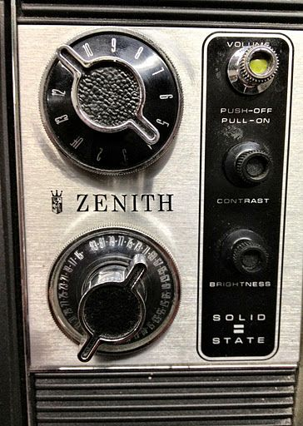
Next, let’s talk about Channels

Slide 79
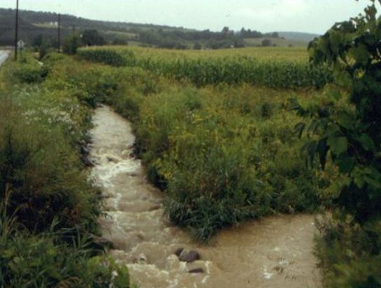
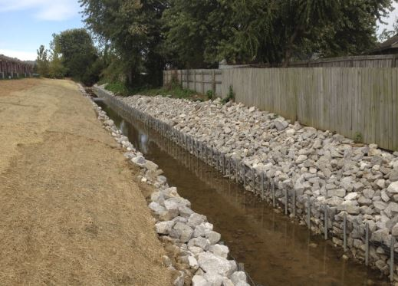
L_CHANNELS
Channel ID
Channel Federated ID
Channel AUID
Channel Type (domain)

Slide 80
Channel Type – Domain Values
Code/Value
Ditch
Aqueduct
Creek
Swale
Stream
Lined channel
Natural channel
Other
Unknown

Slide 81
L_CHANNELS
Channel Height [Depth] (inches)
Channel Width (inches)
Channel Length (feet)

Slide 82
L_CHANNELS
Channel Lining (domain values)
Channel Shape (domain values)

Slide 83
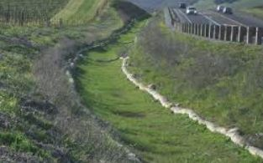
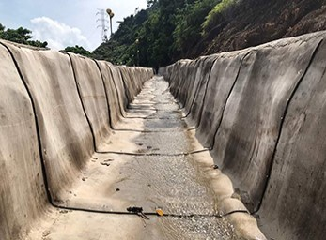
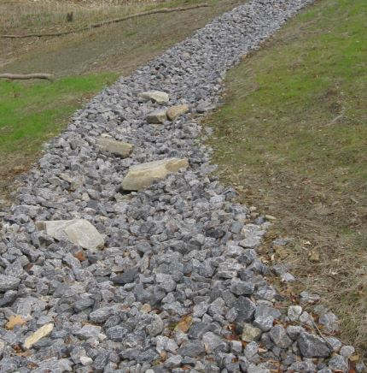
Channel Lining – Domain Values
Code/Value
Vegetation, high
Vegetation, low
Vegetation, unmaintained
Vegetation, other
Concrete
Rock
Riprap
Armored
Fabric
Other
Unknown

Slide 84
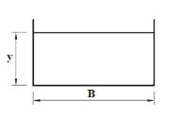
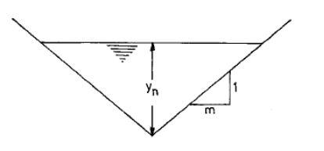
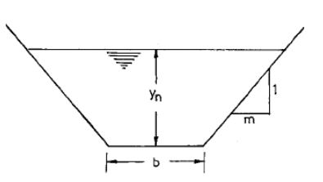
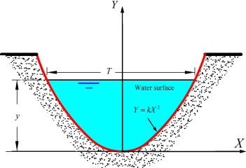
Channel Shape – Domain Values
Code/Value
Natural
Irregular
Triangular
Trapezoidal
Segmental
Parabolic
Other
Unknown

Slide 85
L_CHANNELS
Channel From (ID of the from asset)
Channel To (ID of the to asset)
Channel Status (domain)

Slide 86
Channel Status – Domain Values
Code/Value
Active
Inactive
Removed
Proposed
Abandoned
Other
Unknown
Same as (Pipe Status)

Slide 87
Channel Condition – Domain Values
Code/Value
Excellent
Very Good
Good
Fair
Needs Maintenance
Poor
Very Poor
Non-functioning
Failed
Under construction
Unknown
Too subjective…
Better method?
Less categories?
Numerical rating?
Same as
Pipe Condition?

Slide 88
L_CHANNELS
Channel Condition Date
Channel Installation Date
Channel Modification Date
Channel Vertical Datum
Channel Horizontal Datum
(same as Pipe vDatum/hDatum)

Slide 89
L_CHANNELS
Channel Location (address point, intersection)
Channel As Built (link/URL to relevant file)
Channel Consequence of Failure
Channel Probability of Failure
Channel Criticality to System
1-5 rating system (1=low, 5=high)

Slide 90
L_CHANNELS
Channel Ownership Type*
Channel Ownership Name
Channel Maintenance Authority Type*
Channel Maintenance Authority Name
Channel Producer/Source Type*
Channel Producer/Source Name
*Shared domain: Management Type

Slide 91
Management Type
Code/Value
City
State
County
Judicial
Watershed District
Watershed Management Organization
Township
Educational Entity
Private
Other
Unknown
(add Federal?)
(other values?)

Slide 92
L_CHANNELS
Last Modified (Data) - Date
Channel Easement (Yes, No, Unknown)
CTU Name
CTU Code
County Code
County Name
State Code
Data Source
Comments

Slide 93
Artificial Paths

Slide 94
L_APATH (Artificial Paths)
Artificial Path Status
Code/Value
Active
Inactive
Removed
Proposed
Abandoned
Other
Unknown
Same as:
Pipe Status
Channel Status

Slide 95
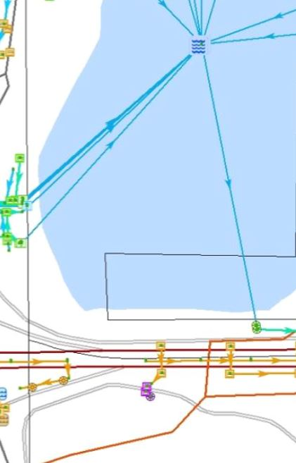
L_APATH (Artificial Paths)
Artificial Path Type
Code/Value
Water connector
Land connector
Spillway
Emergency overflow
Other
Unknown

Slide 96
Management Type
Code/Value
City
State
County
Judicial
Watershed District
Watershed Management Organization
Township
Educational Entity
Private
Other
Unknown
(add Federal?)
(other values?)

Slide 97
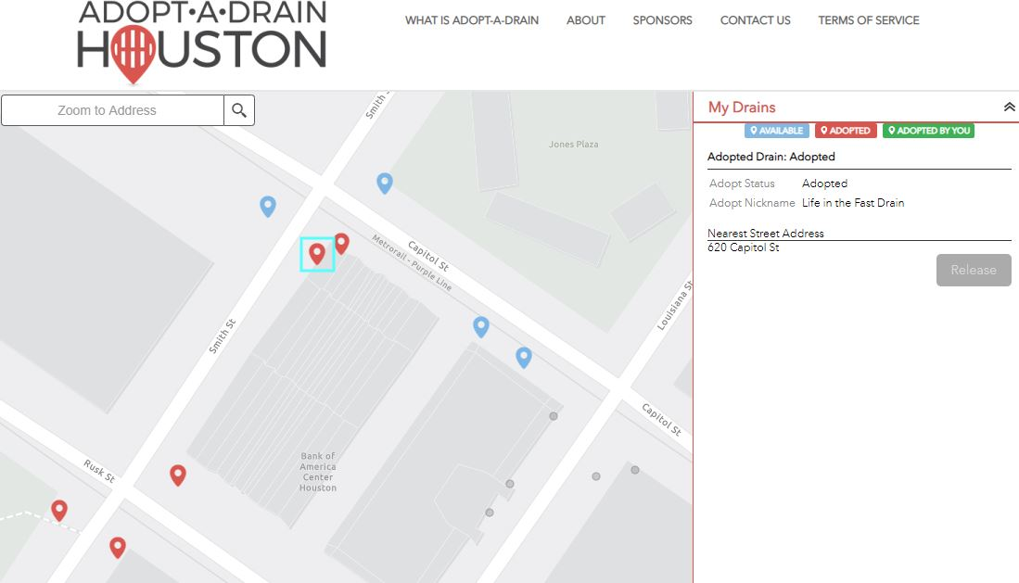
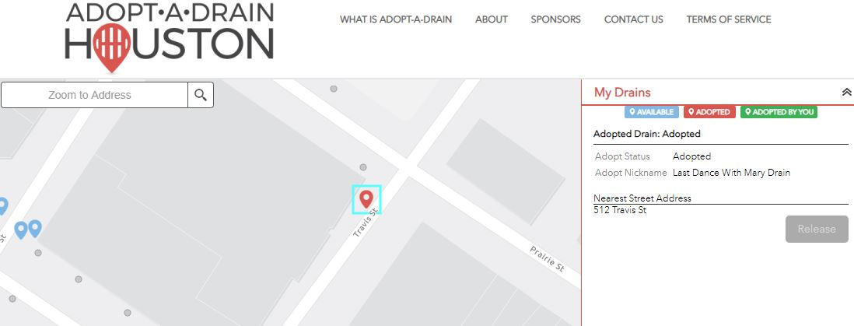
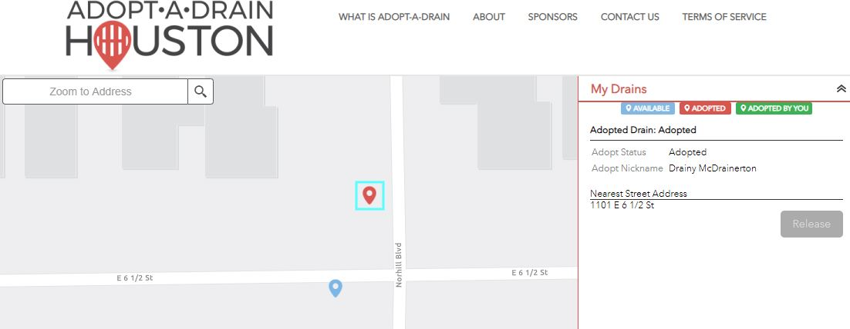

Slide 98
“Life in the Fast Drain”
“Last Dance
With Mary
Drain”
“Drainy
McDrainerton”

Slide 99
Basins (P_BASIN)

Slide 100
P_BASIN
Unique Identifier
Basin Federated ID
Local Parcel ID
DNR Lake ID
PWI Number
Constructed or Natural Origin
Name
Basin Type

Slide 101
Constructed or Natural Origin
Code/Value
Natural
Natural, modified
Constructed
Unknown
Restored to original condition
Restored to modified condition
Restored wetland
Removed as per the direction of the Point/Polygon Team (3/26/19)
Restored

Slide 102
Basin Type
Code
Lake
Pond
Wetland
Constructed Wetland
Culvert, centroid
Detention
Impoundment
Other
Unknown
Filtration with underdrain
Filtration without underdrain
Wet Pond
Dry Pond
Infiltration Trench
Infiltration Basin
Bioretention
Creek (moved to Channel Type)
Swale (moved to Channel Type)
“Junction point”
What is it?
Do we need it?
If so, where should it go?

Slide 103
P_BASIN
Basin Depth (designed depth, feet)
Basin Area (surface area, acres)

Slide 104
P_BASIN
Design Volume (acre feet)
Inspection Frequency (Frequency)
Last Inspection Date
Maintenance Frequency (Frequency)
Last Maintenance Date

Slide 105
Frequency Domain
Code/Value
Monthly
Every two months
Quarterly
Every four months
Twice a year (bi-annual)
Once a year (annual)
Once every two years (biennial)
Once every three years (triennial)
Once every four years (quadrennial)
Once every five years (quintennial)

Slide 106
Last Maintenance Activity
Code/Value
(list of maintenance activity values?)
general maintenance activities
specific maintenance activities
What is the viability, need or potential for carrying this in the standard?

Slide 107
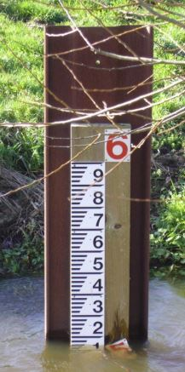
P_BASIN
Infiltration Rate (inches per hour)
Normal elevation (feet)
Highwater elevation (feet)
Low water elevation (feet)
Flood elevation (feet)
Bottom elevation (feet)
Overflow elevation (feet)
Floodstage elevation (feet)

Slide 108
P_BASIN
Vertical Datum
Horizontal Datum
Ordinary High Water Level (feet)
Link to Public As-Builts
Basin Impairment (domain)

Slide 109
Basin Impairment Domain
Code/Value
Impaired
Not impaired
Prior impairment
Maintenance
At risk
Not applicable
Unknown

Slide 110
Basin Impairment Domain
Code/Value
Impaired
Not impaired
Prior impairment
Maintenance
At risk
Not applicable
Unknown
Impairment!

Slide 111
P_BASIN
Basin Ownership Type*
Basin Ownership Name
Basin Maintenance Authority Type*
Basin Maintenance Authority Name
Basin Producer/Source Type*
Basin Producer/Source Name
*Shared domain: Management Type

Slide 112
Management Type
Code/Value
City
State
County
Judicial
Watershed District
Watershed Management Organization
Township
Educational Entity
Private
Other
Unknown
(add Federal?)
(other values?)

Slide 113
P_BASIN
Last Modified (Data) - Date
Basin Easement (is this needed?)
CTU Name
CTU Code
County Code
County Name
State Code
Data Source
Comments

Slide 114
We are going to skip
STRUCTURES for the moment…
…and go straight to BMPs

Slide 115
P_BMPs
Best Management Practices

Slide 116
P_BMPs
BMP ID
BMP Federated ID
BMP Type (domain)
BMP Length
BMP Width
BMP Height or Mean Depth (feet)
BMP Elevation (feet above sea level)
BMP Contributing Drainage Area*
*Applies only to water treatment devices
Land surface area that discharges to the structure, in units of acres

Slide 117
BMP Type – Domain
Amended soils
Filtration basin, no underdrain
Filtration basin, with underdrain
Filtration bench/shelf, no underdrain
Filtration bench/shelf, with underdrain
Filtration swale, no underdrain
Filtration swale, with underdrain
Green roof
Iron enhanced sand filter
NURP pond
Permeable pavement
Planter
Porous pavers
Rain barrel
Rain garden
Storage fixture, aboveground
Storage fixture, underground
Stormwater reuse system
Tree trench
Underground filtration, no underdrain
Underground filtration, with underdrain
Upland preserve
Vegetated buffer
Other
Unknown

Slide 118
P_BMPs
BMP Surface Area (in square feet)
BMP Designed Treatment Volume (gallons?)
BMP Holds Water (Yes, No, Unknown)
BMP Design Infiltration Rate (inches per hour)
BMP Filter Material (domain)
BMP Filter Type (recommended for removal)
BMP Ground Cover (new domain)
BMP Inspection Status (new domain)

Slide 119
BMP Type – Filter Material
Code/Value
Gravel
Rock
Sand compost mix
Sand filter
Sand filter, iron-enhanced
Soil
Spent lime
Other
Unknown
Removed as per the direction of the Point/Polygon Team (3/26/19)
Surface Vegetation
Grass
Vegetation, low maintenance

Slide 120
BMP Type – Filter Type
Code/Value
Surface filter
Underground filter
Perimeter filter
Other
Unknown
This value & domain are
recommended for deletion/removal
by the Point-Polygon Team

Slide 121
BMP Type – Ground Cover
Code/Value
Asphalt
Brick
Concrete
Gravel
Mulch
Soil
Vegetation, high maintenance
Vegetation, low maintenance
Vegetation, native
Other
Unknown
Removed values as per the Point/Polygon Team (3/26/19)
Seeded
Planted
Vegetation, non-native

Slide 122
BMP Type – Inspection Status
Rename as Inspection Cycle?
Code/Value
None
Requires Private Owner Action
Requires Utility Action
Other
Unknown
Removed as per the direction of the Point/Polygon Team (3/26/19):
Resolved
Resolved in field

Slide 123
P_BMPs
BMP Rotation (angle for symbol)
BMP Horizontal Accuracy (domain)
BMP Vertical Accuracy (domain)
BMP Status (domain)
BMP Condition (domain)

Slide 124
Horizontal Accuracy
Code | Value
< 0.1 m | Within 0.1 m or less
0.1 - 0.5 m | Between 0.1 - 0.5 m
0.5 - 1.9 m | Between 0.5 - 1.9 m
2.0 - 4.9 m | Between 2.0 - 4.9 m
5.0 - 9.9 m | Between 5.0 - 9.9 m
> 10 | More than 10 m
Other | Other
Unknown | Unknown
GPS units are in meters
Most other units in our standard are in feet

Slide 125
Vertical Accuracy
Code | Value
<= 0.1 Ft | Less than or equal to one-tenth of a foot
<= 1.0 Ft | Less than or equal to one foot
<= 2.0 Ft | Less than or equal to two feet
<= 5.0 Ft | Less than or equal to five feet
> 5.0 Ft | Greater than five feet

Slide 126
BMP Status
Code/Value
Active
Inactive
Removed
Proposed
Abandoned
Other
Unknown
Same as?:
Pipe Status
Channel Status
Artificial Path Status

Slide 127
P_BMPs
Code/Value
Excellent
Very Good
Good
Fair
Needs Maintenance
Poor
Very Poor
Non-functioning
Failed
Under construction
Unknown
BMP Condition >>
BMP Condition Assessed (date)

Slide 128
P_BMPs
BMP Condition Assessed (date)
BMP Structure Installed (date)
BMP Structure Modified (date)
BMP Vertical Datum
BMP Horizontal Datum

Slide 129
P_BMPs
BMP General Structure Location
(address point/intersection)
BMP Easement (yes, no, unknown)
BMP Link to Public As-Builts
BMP Consequence of Failure
BMP Probability of Failure
BMP Critical to System
1-5 rating system (1=low, 5=high)

Slide 130
P_BMPs
BMP Ownership Type*
BMP Ownership Name
BMP Maintenance Authority Type*
BMP Maintenance Authority Name
BMP Producer/Source Type*
BMP Producer/Source Name
*Shared domain: Management Type

Slide 131
P_BMPs
Last Modified
CTU Name
CTU Code
County Code
County Name
State Code
Data Source
Comments

Slide 132
Monitoring Devices

Slide 133
P_MONITOR:
Monitor ID
Monitor Federated ID
Monitor Category (domain)
Monitor Type (domain)

Slide 134
Monitor Category
Code/Value
Sensor
Monitoring well
Sampler
Gauge
Other
Unknown
<< Recommended addition from the
Point-Polygon Team

Slide 135
Monitor Type
Flow sensor
Pressure transducer sensor
Water level sensor
Temperature sensor
Conductivity sensor
Sonic distance sensor
Laser velocity sensor
Automated sampler
Staff gauge
Rain gauge
Bubbler for water depth
Turbidity sensor
pH sensor
Dissolved oxygen sensor
Algae sensor
Chlorophyll sensor
Soil moisture gague
Other
Unknown
Monitoring well, water level only*
Monitoring well, temporary dewatering, construction*
Monitoring well, remedial site investigation, water quality*
Monitoring well, geological, exploratory*
Monitoring well, general water quality*
*Recommended additions from the
Point-Polygon Team

Slide 136
P_MONITOR:
Height or Mean Depth (feet)
Elevation (feet above mean sea level)
Contributing Drainage Area (acres)
Symbol Rotation (degrees)
Horizontal Positional Accuracy
Vertical Positional Accuracy

Slide 137
Horizontal Accuracy
Code | Value
< 0.1 m | Within 0.1 m or less
0.1 - 0.5 m | Between 0.1 - 0.5 m
0.5 - 1.9 m | Between 0.5 - 1.9 m
2.0 - 4.9 m | Between 2.0 - 4.9 m
5.0 - 9.9 m | Between 5.0 - 9.9 m
> 10 | More than 10 m
Other | Other
Unknown | Unknown
GPS units are in meters
Most other units in our standard are in feet

Slide 138
Vertical Accuracy
Code | Value
<= 0.1 Ft | Less than or equal to one-tenth of a foot
<= 1.0 Ft | Less than or equal to one foot
<= 2.0 Ft | Less than or equal to two feet
<= 5.0 Ft | Less than or equal to five feet
> 5.0 Ft | Greater than five feet

Slide 139
P_MONITOR:
Device Brand
Device Maintenance
Device Maintenance Type
Manufacturer Date
Monitor Status (needs a domain)
Monitor Condition
Date Condition Assessed
Date Device Installed
Date Device Modified
Date Device Expires

Slide 140
P_MONITOR:
Vertical Datum
Horizontal Datum

Slide 141
P_MONITOR:
Monitor Ownership Type*
Monitor Ownership Name
Monitor Maintenance Authority Type*
Monitor Maintenance Authority Name
Monitor Producer/Source Type*
Monitor Producer/Source Name
*Shared domain: Management Type

Slide 142
Management Type
Code/Value
City
State
County
Judicial
Watershed District
Watershed Management Organization
Township
Educational Entity
Private
Other
Unknown
(add Federal?)
(other values?)

Slide 143
P_MONITOR:
Last Modified
CTU Name
CTU Code
County Code
County Name
State Code
Data Source
Comments

Slide 145
Worst. Drain. Ever.

Slide 146
OK, now we dive into
P_STRUCTURES

Slide 147
P_STRUCTURES
Point features representing:
Manholes
Inlet (Inflow)
Outlet (Outflow)
Outfalls
Control Structures
Treatment Devices
List of 77 Structure Types

Slide 148
STRUCTURES
Similar in many respects to our
other components…

Slide 149
STRUCTURES Discussion:
Breakout STRUCTURES into two (more?)
discrete categories?
STRUCTURES
PIPE_ENDS
Retain STRUCTURES as a single entity with numerous attributes in place to help whittle it down for use.

Slide 150
STRUCTURES
>> Manholes
>> Control Structures
>> Catch Basins
>> Treatment Devices
PIPE_ENDS
>> Inlets
>> Outlets
>> Outfalls

Slide 151
STRUCTURES
>> Manholes
>> Control Structures
>> Catch Basins
>> Treatment Devices
PIPE_ENDS
>> Inlets
>> Outlets
>> Outfalls
Reduce
further?
Reduce
further?

Slide 152
STRUCTURES
Catch Basin:
>> Dimensions
>> Location
>> Material
>> Function

Slide 153
STRUCTURES
Catch Basin:
>> Dimensions
>> Location
>> Material
>> Function

Slide 154
STRUCTURES
Catch Basin/
With Sump
>> Dimensions
>> Location
>> Material
>> Function

Slide 155
STRUCTURES
Flared End Section
>> Dimensions
>> Location
>> Material
>> Function

Slide 156
STRUCTURES
Outlet
>> Dimensions
>> Location
>> Material
>> Function

Slide 157
STRUCTURES
Pond Outlet Structure example

Slide 158
STRUCTURES
How can we (geospatial) create the best schema(s) to
be able to effectively represent and attribute these stormwater fixtures for maximum usability?
So that:
>> The geospatial data accurately represents the fixture
>> It can be consumed by/used for hydraulic/flow modeling
>> It can crosswalk into/out of asset management software
>> It meets the other needs we’ve identified and documented

Slide 159
Moving forward
#1 ) Keep STRUCTURES as is and test it out within the pilot project
#2 ) Split it into two features
STRUCTURES and PIPE_ENDS
#3 ) Split it into numerous features

Slide 160
#1 ) Keep STRUCTURES as is and test it out within the pilot project
#2 ) Split it into two features STRUCTURES and PIPE_ENDS
#3 ) Split it into numerous features
Willingness of participants to:
“Plunge and Parse”
These into this >>

Slide 161
Agenda Item 6:
Review Next Steps
Agenda Item 7:
Next Meeting
City of Bloomington
Late July 2019

