Slide 1
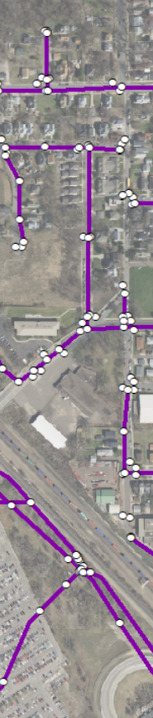


METRO STORMWATER GEODATA PROJECT
Steering Team Meeting #3
November 14, 2018
Blaine City Hall
10801 Town Square Drive NE

Slide 2
1 ) Welcome/Introductions
2 ) Short Re-Cap, Updates & Housekeeping
Point, Line, Polygon Teams
Work forms the basis of our data standard

Slide 3
Point, Line & Polygon Teams
Presented in Chaska in August
Their work serves to form the basis for our emerging data standard;

Slide 4

Grant Application ($18,785)
University of Minnesota
Water Resources Center
Proposal submitted on behalf of the MSGP
Funds to pay either a vendor, city or watershed district staff to translate sample data into our forthcoming standard

Slide 5
Outreach & Presentations
Wednesday, November 7, 2018
Conference on the Environment
Minneapolis
Friday, November 30, 2018
Minnesota Association of Watershed Districts
Alexandria

Slide 6
Agenda Item 3
Asset Management Team

Slide 7
Metro Storm Water Geodata Project- Asset Group

Slide 8
Recommendation Field
Recommendation (Rec) | Description
Yes | Asset Management Software (AMS) or workflows depend on these GIS attributes
Convenience | Use of field would be convenient but possible to derive from existing fields
AMS | Field may exist in an AMS. These fields could be used in the absence of an AMS

Slide 9
Basics
Field Name | Alias | Rec | Geometry Type | Description
AssetID | Facility Id / Asset Id | Yes | * | Primary Key used by asset Owner/Manager to track work activity on the asset. Specific type and length of the field may be customizable by each agency. Field length set to 75 in order to accommodate Global Id fields. Can make longer if needed
Location | Location | Yes | * | General Location – Address, Intersection, or descriptive location

Slide 10
Life Cycle Delivery
Field Name | Alias | Rec | Geometry Type | Description
LifeCycleStatus | Life Cycle Status | Yes | * | Life Cycle Status of the Asset (Active, Removed, Proposed, Abandoned).
INSTALLDATE | Install Date | Yes | * | Date of install (within 1 week)
InstallYear | Install Year | Convenience | * | Year Asset was installed (If specific date is unknown).
WarrantyDate | Warranty Date | Convenience | * | Date warranty expires
Age | Age (Years) | Convenience | * | Age of Asset in Years
lifeExpectancy | Life Expectancy (Years) | AMS | * | Number of years the asset is expected to be in service
replacementYear | Replacement Year | AMS | * | Year the asset is scheduled for replacement
replacementCost | Replacement Cost ($) | AMS | * | Estimated cost to replace the asset
replacementCostYear | Replacement Cost Year | AMS | * | Year the estimated cost applies to
replacementCycle | Replacement Cycle | AMS | * | Number of years to pass before asset is scheduled to be replaced
replacementMethod | Replacement Method | AMS | * | Method used to determine when asset will be replaced (Scheduled, Condition Based, Run to Failure, etc.)
Condition | Condition | Yes | * | Condition of the Asset (Mark to Removed when Removed and Update the Condition Date)
ConditionDate | Condition Date | Yes | * | Date Condition was recorded

Slide 11
Operations & Maintenance
Field Name | Alias | Rec | Geometry Type | Description
Size Attributes |  | Yes | Varies | Multiple fields depending on type of Asset (diameter, length, width, etc.)
Slope/Capacity |  | Convenience |  | Identifying pipes meeting cleaning velocities
invertElevation | Invert Elevation | Yes
Material Attributes |  | Yes | Varies | Type of Material
type | Structure Type | Yes |  | Definition of the structures function
projectPlanNumber | Project / Plan Number | Yes |  | Name of the linked file for public viewing
asBuiltLink | As-Built Link | Yes/Non Public | * | Link to O & M Manual and/or As-Built Drawings. O & M Specific
pmDescription | PM Description | AMS |  | Name of the PM Description that applies to the Asset (if only 1 PM activity)
pmCycle | PM Cycle | AMS |  | Cycle in Months or based on Meter
lastPMDate | Last PM Date | AMS |  | Date of Last PM
OWNEDBY | Owned By | Yes | * | Asset Owner
MAINTBY | Managed By | Yes | * | Asset Manager
maintAgreement | Maintenance Agreement | Yes |  | Link or Text describing maintenance agreement

Slide 12
Risk
Field Name | Alias | Rec | Geometry Type | Description
CoF | Consequence of Failure | AMS |  | 1 – 5 Rating with 1 being low and 5 being High
PoF | Probability of Failure | AMS |  | 1 – 5 Rating with 1 being low and 5 being High
criticallity | Criticality | AMS |  | Product of Cof & Pof. 1 - 25 Rating with 1 being Low and 25 being Very High.

Slide 13
Level of Service
Field Name | Alias | Rec | Geometry Type | Description
customerLOS | Customer LOS | AMS |  | Level of Service the customer expects from Asset (Group)
closQuality | Customer Quality | AMS
closFunction | Customer Function | AMS
closCapacity | Customer Capacity | AMS
technicalLOS | Technical LOS | AMS |  | Level of Service Operations and Maintenance Staff expect from Asset
tlosOperations | Technical Operations | AMS
tlosMaintenance | Technical Maintenance | AMS

Slide 14
Financial
Field Name | Alias | Rec | Geometry Type | Description
costNew | Cost of Asset | AMS
usefulLife | Useful Life | AMS
residualLife | Residual Life | AMS
depreciation | Depreciation | AMS

Slide 15
MS4 Inspection Fields - Compliance
MS4 inspections focus on illicit discharge detection but also record basic condition and function information
Would like to explore MS4 related attributes and fields as a standard
Overlap exists with other teams
Waiting for PCA input / recommendation

Slide 16
Detailed Inspections - Condition
Detailed condition inspections are an important tool for asset management, they are used to identify preventative maintenance needs, and to determine rehabilitation and replacement projects
Related tables for each asset class where appropriate
Simple conversion of existing inspection forms from agencies that have established inspection programs such as MnDOT
Not an official standard, end users can choose to implement or not, use as is or customize
Big benefit to agencies that have nothing
  Easy to implement with standard GIS knowledge, can be inspecting assets in a couple hours

Slide 17
Detailed Inspections
Include with this Standard or not?
Are inspections something that should be kept in GIS or should it be a connected system?
Does the committee want to include inspections as part of the standard?
Would the committee like Asset Management to take this on or have a separate group form?

Slide 18
Glossary
Propose a Standardized Glossary for this Project

Slide 19
Glossary Examples
Acronym | Term | Definition | Source
AMS | Asset Management System | Management system for asset management whose function is to establish asset management policy and asset management objectives | IAM
AMS | Asset Management Software | Software used to assist with Asset Management practices
BRE | Business Risk Exposure | A measure of overall Asset Risk and is estimated by considering and combining the Probability of Failure (PoF) and the Consequence of Failure (CoF) of an Asset. | AWWA AM Definition Guidebook Version 1.0
CoF | Consequence of Failure | A measure of the direct and/or indirect costs of Asset failure. Direct costs are out of pocket costs to the Asset owner such as the cost of water loss, Repairs, fines, property damage, etc. Indirect costs are typically not paid directly by the Asset owner and may include costs of business or customer interruptions, traffic delays, public perception or reputation, and property costs not paid by the Asset owner, etc. Costs are also often categorized as "Triple Bottom Line" or TBL which refers to financial, environmental and societal costs. | AWWA AM Definition Guidebook Version 1.0
 | Criticality | An Asset prioritization measure often used to determine "what" Assets to focus on. Criticality is normally based on potential Consequences of Failure, not Risk, and is used to determine higher priority Assets for Risk Management activity. | AWWA AM Definition Guidebook Version 1.0
LOS | Level of Service | parameters, or combination of parameters, which reflect social, political, environmental and economic outcomes that the organization delivers | IAM
 | Life Cycle | Stages involved in the management of an Asset (ISO 55001, 2014). These stages or activities include asset planning, design, construction, commissioning, operation, maintenance, and retirement/decommissioning. | AWWA AM Definition Guidebook Version 1.0
O & M | Operations and Maintenance | Department responsible for operating and maintaining assets. Sometimes referred to as Public Works, Water Works, Public Utility, etc.
PM | Preventative Maintenance | Maintenance regularly performed to reduce the likelihood of failure. Can be completed based on time, meter reading, or condition
PoF | Probability of Failure | A measure of the likelihood of an event happening at a point in time, normally expressed as a numeric frequency or as a percentage. All Failure Modes should be considered when determining the Probability of Failure (capacity, level of service, efficiency and physical mortality). The probability can be determined qualitatively or quantitatively from available data, such as Asset age, performance and Condition Assessment results, operation and maintenance history, demand forecasting, cost analysis, and experiences with that type of Asset in general. | AWWA AM Definition Guidebook Version 1.0

Slide 20
Agenda Item 4
Routing Team Findings

Slide 21
Routing Business Needs
Flow tracing
Emergency response
Operation and maintenance
Identifying flood risk
Identifying conveyance system insufficiencies
Estimated development/re-development impacts
Surface and ground water quality protection/restoration
Capital planning

Slide 22
Modeling stormwater flow:
Determine where and how water is conveyed through the constructed and natural network
Determine how barriers in the system impact stormwater flow

Slide 23
Determine where and how water is conveyed through the constructed and natural network
Feature data requirements:
Constructed and natural features that convey water into, through and out of our region…

Slide 24
Common point features that convey stormwater
Inlets, outlets and points in-between:
Catch basins
Manholes
Pipe aprons
Outfall, discharge locations
Pump/lift stations
*Various BMPs
*Basins, lakes, ponds
*May be represented through other geometry types

Slide 25
Common line features that convey stormwater
Pipes
Channels
Ditches
Swales
Streams
Artificial paths

Slide 26
Common polygon features that convey stormwater
Water bodies (lakes, ponds, wetlands)
Various BMPs (e.g. rain gardens)
Polygons are not required inputs for modeling stormwater flow
ESRI’s new Utility Network allows for polygons to be used (structure boundaries), where the old Geometric Network used points and lines (junctions and edges)

Slide 27

Determine where and how water is conveyed through the constructed and natural network
In order to allow for basic flow tracing in GIS,
Certain geometry and attribute components should exist:
Geometry Requirements
Feature connectivity
Line directionality
Attribute Requirements
Invert elevations of line endpoints
Active/inactive status of conveyance features

Slide 28
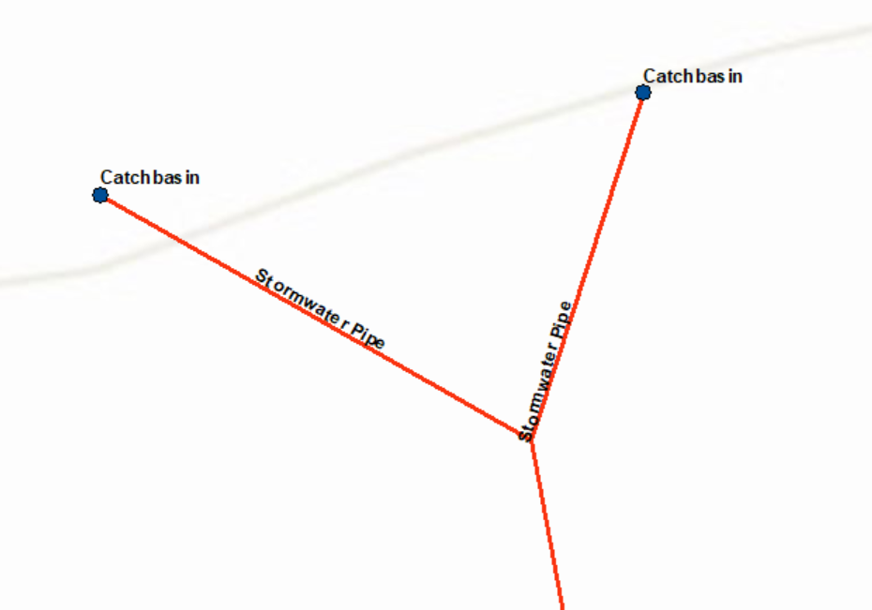
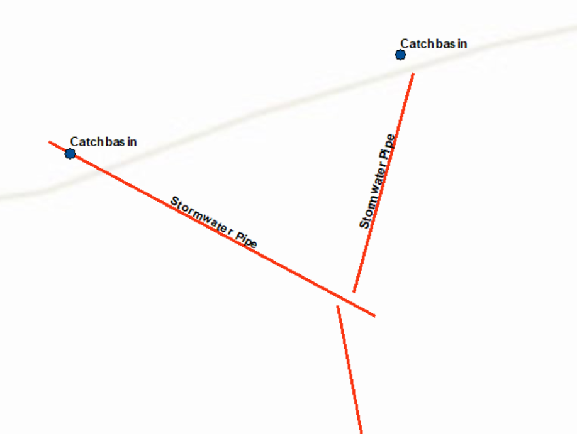
Geometry Requirements
Feature Connectivity:
Line features that convey water from one to another must be connected (“snapped”) at their endpoints;
2. Point features that convey water to or from line features must be
connected to the line endpoints

Slide 29
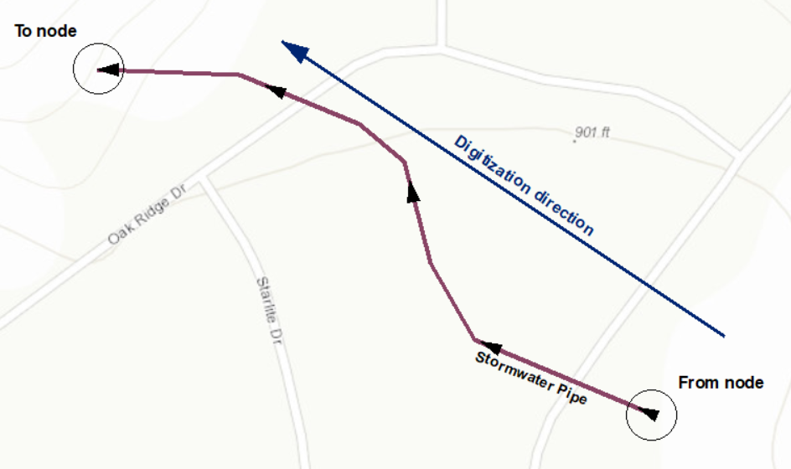
Geometry Requirements
Line Directionality:
1. Line features should be digitized in a direction that always follow with or against the flow of water, not both;

Slide 30
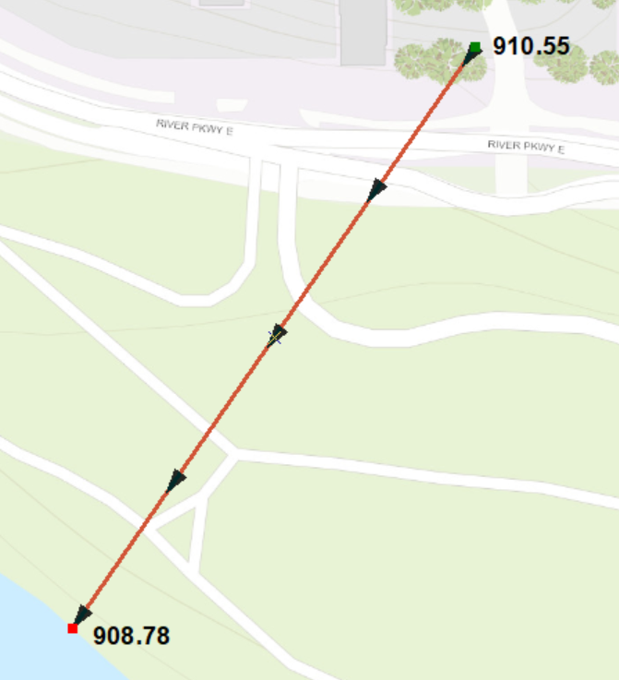

Attribute Requirements
Elevations of line endpoints:
Invert elevation values should be stored in fields for line endpoints
  From invert elevation = beginning node
  To invert elevation = end node

Slide 31
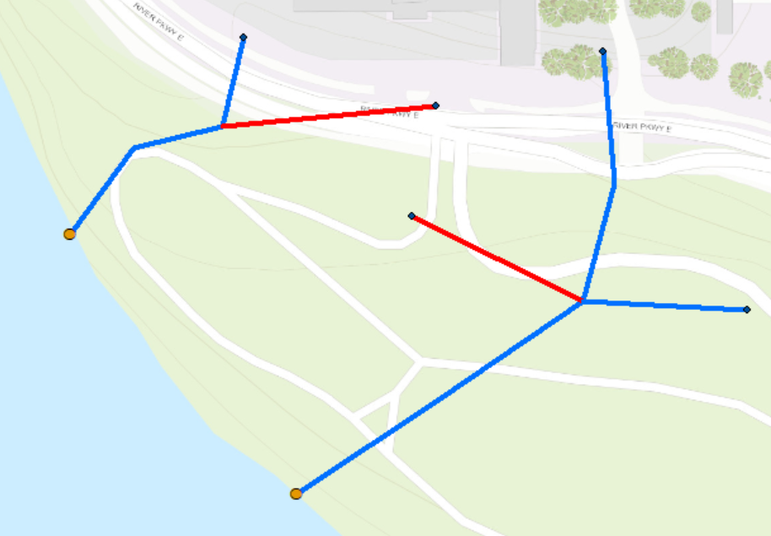

Attribute Requirements
Active, inactive status of conveyance features:
A status field should carry values indicating whether the features are currently active (i.e. open and able to convey stormwater) or not
    ESRI’s stormwater data models use a field called “Active Flag” to handle this

Slide 32
Determine how barriers in the system impact stormwater flow
Barriers and impediments are analyzed AFTER a geometric or utility network has been created from the data.
Likely out-of-scope for our project?
Recommendation:
Primary focus should be on preparing the data in a way that it can be transformed into a network model for further analysis

Slide 33
Future Consideration - Associations
In ESRI’s Utility Network extension, associations allow junctions to be connected without lines (i.e. “edges”) physically making the connection
May remove the need for altering geometry to make it traceable.
May remove the need for artificial paths

Slide 34
Utility Network Model:
All Feature Classes contain the following for fields: Global ID, Editor tracking fields (attribute assistant fields like Created By or Edit Date), Asset Group, & Asset Type
Subtypes are gone and replaced with asset groups & asset types
Connectivity in managed in network types
Associations allow for the connection of two junctions without having a physical edge between them. This is significant in our work in that it might eliminate the need for artificial paths.
Have a Structure Network feature classes
  Structure Line – Linear features that support the domain (pipe casing)
  Structure Junction – Point features that a device is attached to or a container (pump station)
  Structure Boundary – Polygon feature such as a lake or the building footprint of a pump station
Have a Domain Network feature classes
  Devices – Point feature controllable or defines a source. Features like a meter
  Line – linear feature such as a main
  Junction – point feature that defines connectivity between lines and such as fittings
The move from the
Geometric Network Model to the
ArcGIS Pro Utility Network model
Geometric Network Model:
The network is combined of:
  Junctions – points like Manholes or fittings
  Edges – lines such as mains or connections
  Connectivity Rules – Mains must have a manhole at their end – features must be connected for tracing to work.
  Weights – You could assign higher values to make sure a path is favored over another.
Source: Avineon, “Esri’s Utility Network vs. Geometric Network: A Technical Comparison”
esri, “Getting to Know the Utility Network”

Slide 35
The move from the
Geometric Network Model to the
ArcGIS Pro Utility Network model
Utility Network Model (cont.)
Domain Network feature classes continued:
  Assembly – Complex point features like a pump station
  Subnetline (System Maintained) – Collection of lines that define the extent of a resource flow.
Connectivity & Rules
  Define what features can do in terms of connectivity

Slide 36
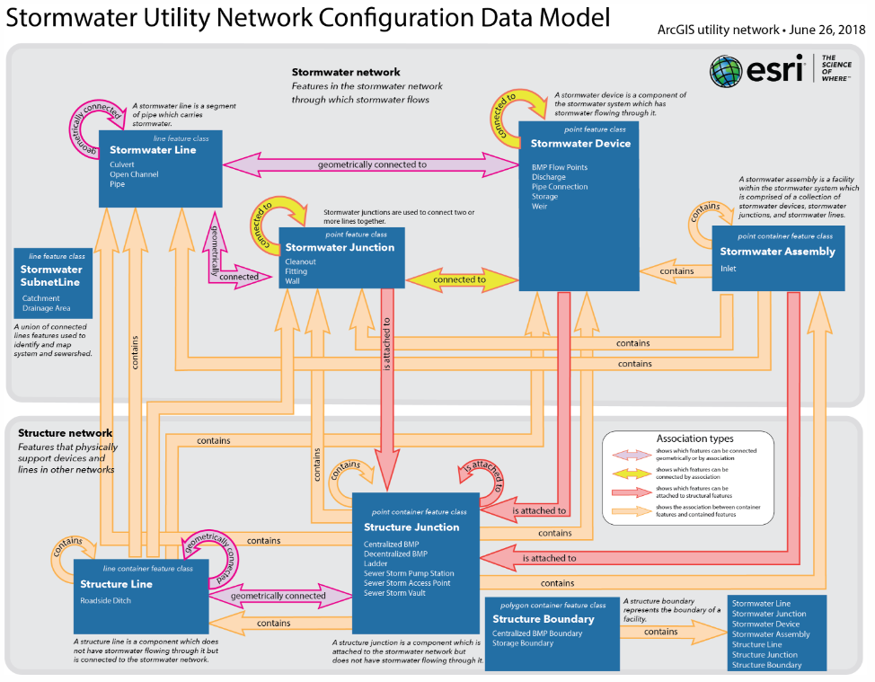
Information from esri website, https://solutions.arcgis.com/water/help/stormwater-utility-network-configuration/use/what-is-the-stormwater-data-model.htm

Slide 37
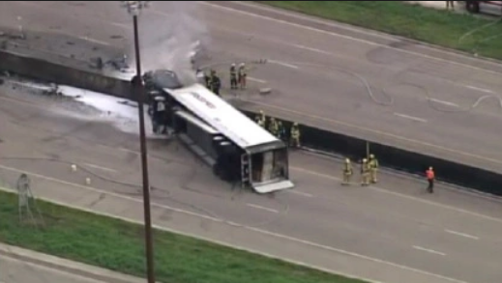
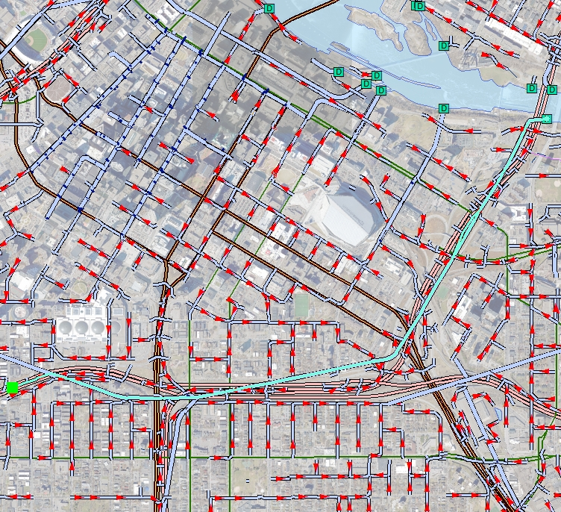
Business Need: Emergency Response
Sometimes there are bad days when tracing of stormwater can come in handy…
Tracing of stormwater during an Emergency Response event can be invaluable in protecting our waters;
By selecting the nearest inflow point in your data to the spill event you are able to trace downstream all of the effected waters as well as plan where you will set up containment to get rid of the spilled material from the system to hopefully avert ecological damage or harmful impact to the Public.

Slide 38
Business Need: Operation and Maintenance
Potential Opportunities
Overlaps with Asset Management Team
Determining locations critical junctions or lines to network for preventative maintenance
Determining areas where there are system deficiencies within a network. Using cost/impediment values for size, slope, material, etc.
Areas where deficiencies may require greater preventative maintenance.
Further considerations

Slide 39
Routing Business Needs
Flow tracing
Emergency response
Operation and maintenance
Identifying flood risk
Identifying conveyance system insufficiencies
Estimated development/re-development impacts
Surface and ground water quality protection/restoration
Capital planning
Met by stormwater quantity and quality analysis.

Slide 40
Stormwater Quantity and Quality
Analysis Data Needs
Water Quantity (flood risk, pipe insufficiencies, inundation maps)
  Hydrology – calculates excess precipitation (i.e., runoff) from the landscape
  Hydraulics – simulates the movement of stormwater through elements that convey, store, or in some way control runoff.
Water Quality (analyzing watershed loading, BMP pollutant removals)
  Hydrology – excess precipitation and pollutant concentrations
  Hydraulics – simulates the movement of stormwater through elements that convey, store, or in some way control with an emphasis on treatment features that capture or treat pollutants in stormwater runoff

Slide 41
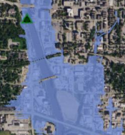
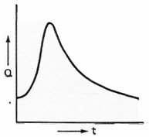
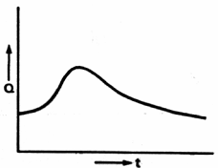
Stormwater Quantity and Quality
Analysis Data Needs
Hydrology
Hydraulics
Pipe
Catch basins
Stormwater pond
Flood Inundation Map
Routed Hydrograph
Runoff
Hydrograph

Slide 42

Stormwater Quantity and Quality
Analysis Data Needs
Schematic Overview
Hydrology
Catchments
Land use
Soil types
Impervious
Business Needs
Flood risk
Pipe Insufficiencies
Planning
Surface water protection/restoration planning
Assess development local and regional impacts
Output
Hydraulics
Connectivity
Geometry dimensions
Computational Engine
(e.g. XP-SWMM, P8, custom programming, etc.)
Stormwater Geodatabase

Slide 43
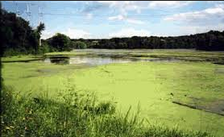
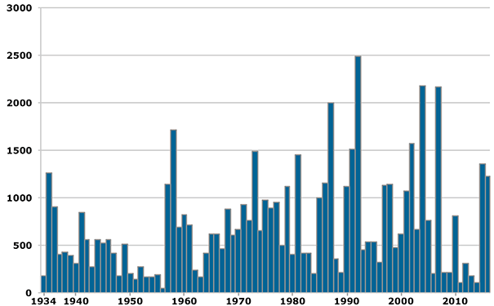
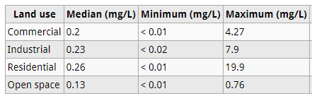
Stormwater Quantity and Quality
Analysis Data Needs
Hydrology
Hydraulics
Pipe
Catch basins
Stormwater pond
Pollutant Concentrations
Receiving Water
Long-term
simulation

Slide 44
Stormwater Quantity and Quality
Analysis Data Needs
Basic Needs
  Network
  Physical attributes – size, material, type, elevation
Additional
  Stormwater controls (i.e., stormwater pond)
    Storage (elevation-area)
    Infiltration features (infiltration rates)
    . . . .
  Support catchment delineation and linkage to catchment details?
  Support surface overflows (secondary overflow routes)?
  Support analysis output?

Slide 45
Stormwater Quantity and Quality
Analysis Data Needs
Example XP-SWMM Database
Point layer – modeling nodes (∼35 attributes)
Polygon layer – catchment areas (∼ 30 attributes)
Line feature – Links (pipes, channel, etc.), Weirs, Orifices, Pumps (∼ 10-45 attributes)
Tabular data – Storage, infiltration, cross sections, pump curves, etc.
∼ 50 domains
Stormwater Geodatabase

Slide 46
Agenda Item 5
MPCA – MS4 Permit Req’s

Slide 47
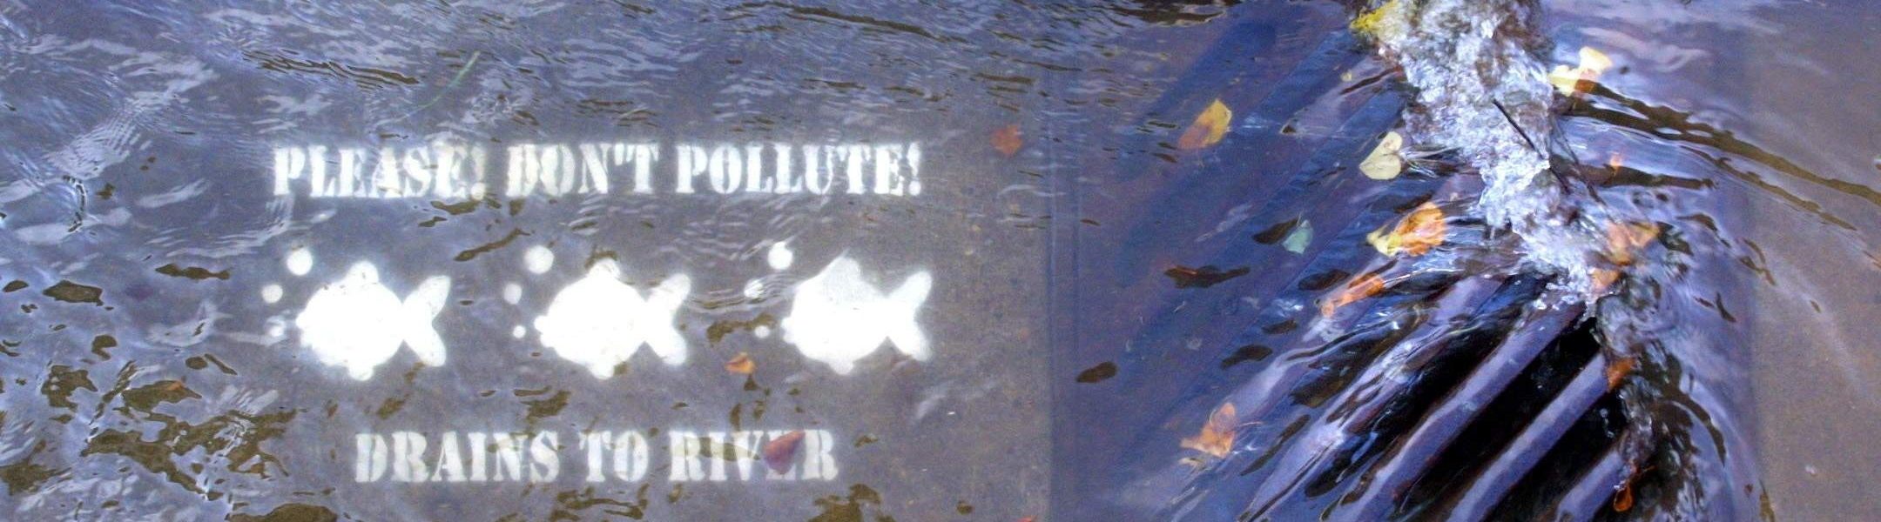
MS4 Mapping Requirements
Rachel Olmanson| Stormwater TMDL Liaison
11/14/2018

Slide 48
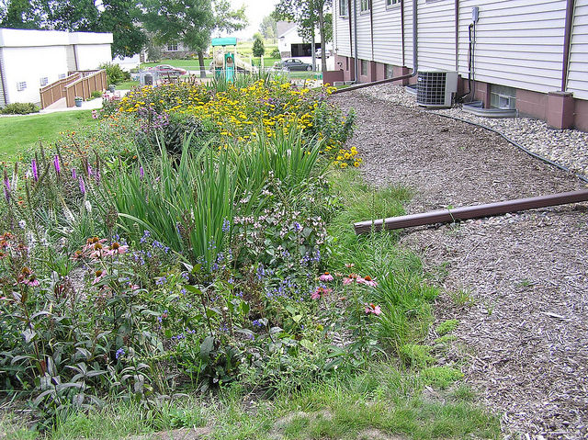
MS4 Permit
Authorizes clean stormwater discharges
Applies to 250 entities:
  Counties, Cities, Townships
  Watershed Districts
  MN Department of Transportation
  Universities/Colleges, Hospitals/Medical Centers, Correctional Facilities
Note: Minneapolis and St. Paul have individual permits

Slide 49
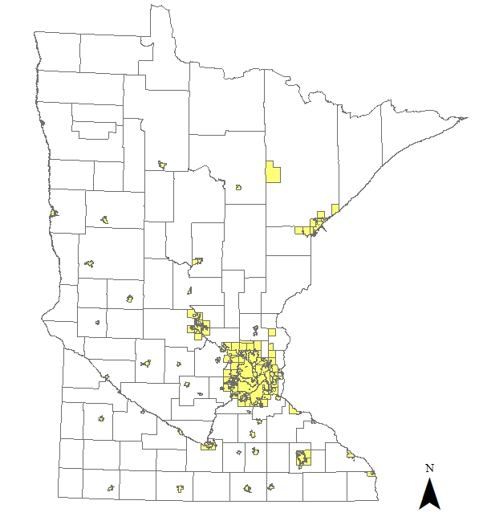
MS4 Boundaries
175 Cities
15 Counties
27 Townships
9 Watershed Districts
24 Other
MnDOT

Slide 50
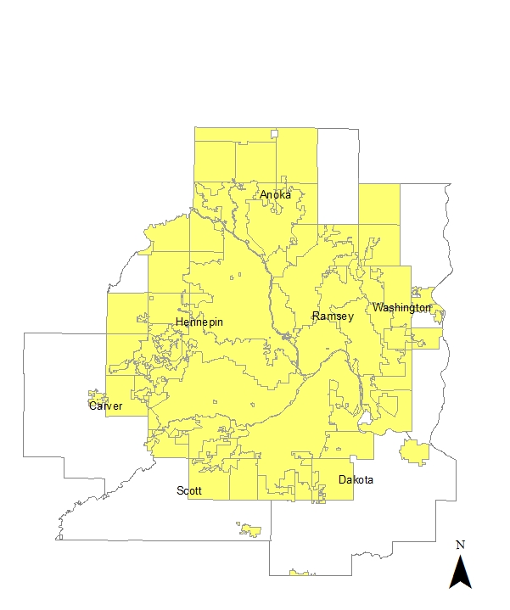
MS4 Boundaries
123 Cities
7 Counties
8 Townships
8 Watershed Districts
12 Other
MnDOT

Slide 51

MS4 Permit
Requires a stormwater pollution prevention program (SWPPP) that contains:
Public education and outreach
Public Participation and involvement
Illicit Discharge Detection & Elimination
Construction Site Stormwater Control
Post Construction Stormwater Management
Pollution Prevention/Good Housekeeping

Slide 52
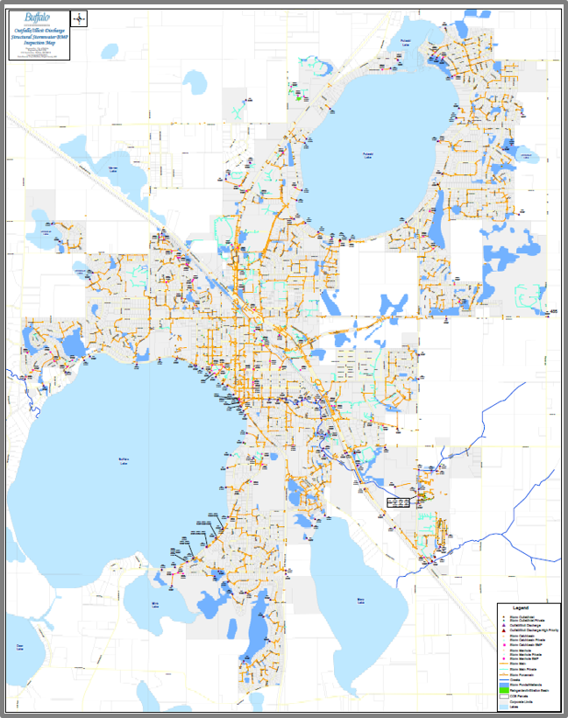
Illicit Discharge Detection and Elimination
Detect and eliminate non-stormwater discharges to the MS4
  Adopt rules that prohibit illicit discharges
  Map the MS4
  Inspect for, investigate, and eliminate illicit discharges
  Train staff on illicit discharge recognition

Slide 53
Small MS4 Permit
Permittees shall develop/update a storm sewer system map that depicts the following:
a. The permittee’s entire small MS4 as a goal, but at a minimum, all pipes 12 inches or greater in diameter, including stormwater flow direction in those pipes
b. Outfalls, including a unique identification (ID) number assigned by the permittee, and an associated geographic coordinate
c. Structural stormwater BMPs that are part of the permittee’s small MS4
d. All receiving waters

Slide 54
Minneapolis/St. Paul Permit
Update an electronic inventory and map of the storm sewer system, identifying:
(1) Receiving waters.
(2) Structural stormwater BMPs (except catch basins and storm drain inlets without sumps), including:
  (a) The size of the subwatershed area draining to the structural stormwater BMP.
  (b) The design capacity, estimated design capacity or size of the structural stormwater BMP.
  (3) Land use types.
  (4) All pipes, ditches and swales, including stormwater flow direction. Catch basin lead pipes must be added, when applicable.
  (5) Permittee-owned facilities.

Slide 55
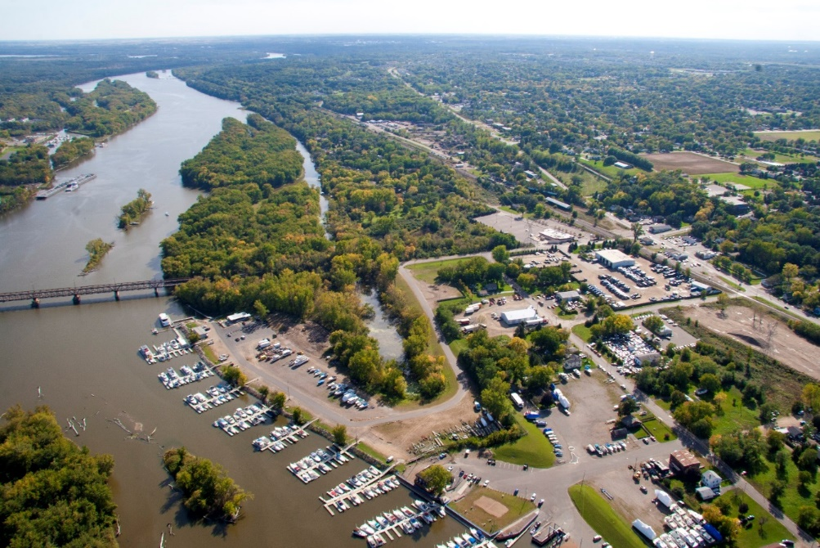
Minneapolis/St. Paul Permit
  (6) Outfalls, including:
  (a) Outfall identification number.
  (b) Geographic coordinate of outfall location.
  (c) Size of outfall pipe.
  (d) Size of the subwatershed area draining to each outfall.
  (e) % of impervious surfaces in the subwatershed area draining to each outfall.
  (f) The number and type of structural stormwater BMPs in the subwatershed area that drains to each outfall.
  (7) Stormwater inflows from other MS4s

Slide 56
Questions?

Slide 57
Agenda Item 6
Data Policy Work Progress

Slide 58
Data Policy Work Progress
Draft Disclaimer Language:
Built on existing language already approved
Additional statements related to infrastructure
Data Practices Office
In communication with DPO
Data is presumed under law to be public
Does not mean you are required to publish it

Slide 59
Data Policy Work Progress
Data Practices Office (DPO):
Can make a determination if portions of the
Data Practices Act apply
DPO can reply to a formally tendered letter:
Later in the MSGP project we can draft a letter
that more specifically asks for what we are
looking for (guidance, definitions, etc.)

Slide 60
Is it public data? Yes
Does a producer have to publish it? No
If a citizen wants the data, can they submit a
Data Practices Act request that the producer
must respond to? Yes
Do the provisions of 13.03, Sub 3(d) apply? Yes

Slide 61
If it is published or given out with errors or
omissions in the data, is the data producer liable?
No, as long as the data producer has a suitable
disclaimer with the data; (§466.03, Subd. 21)
If it is acquired by urban spelunkers and one of
them dies or is injured, is the data producer liable?
No, a trespasser assumes all liability and
consequences for their actions;

Slide 62
Can statutory ‘security information criteria’
be applied to it?
To be determined, very likely yes;
Can a data producer redact or remove attributes
it does not want to share with the public?
To be determined, very likely yes;

Slide 63
Agenda Item 7 )
Pilot Project/Proof-Of-Concept
Study Area Determination

Slide 64
Determine where we want to try it out
‘pilot project area’ (or ‘areas’)
Why do this?
More manageable geography
Easier to work with a smaller area to start with
‘Control’ group of data to test
Communication with an initial set of stakeholders
Test bed for failure, revision, correction, etc.

Slide 65
Determine where we want to try it out
‘pilot project area’ or ‘areas’
Why do this?
More manageable geography
Easier to work with a smaller area to start with
‘Control’ group of data to test
Communication with an initial set of stakeholders
Test bed for failure, revision, correction, etc.
Why do this now?
Establish communication early and often with the
authoritative sources of the data

Slide 66
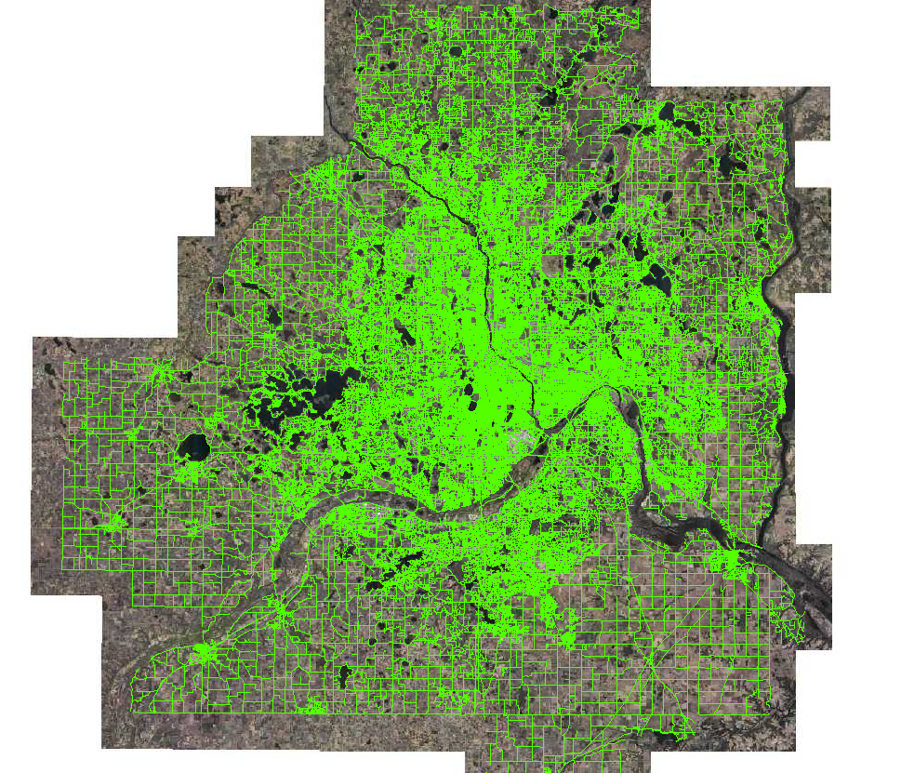

MRCC
Started in 2014

Slide 67
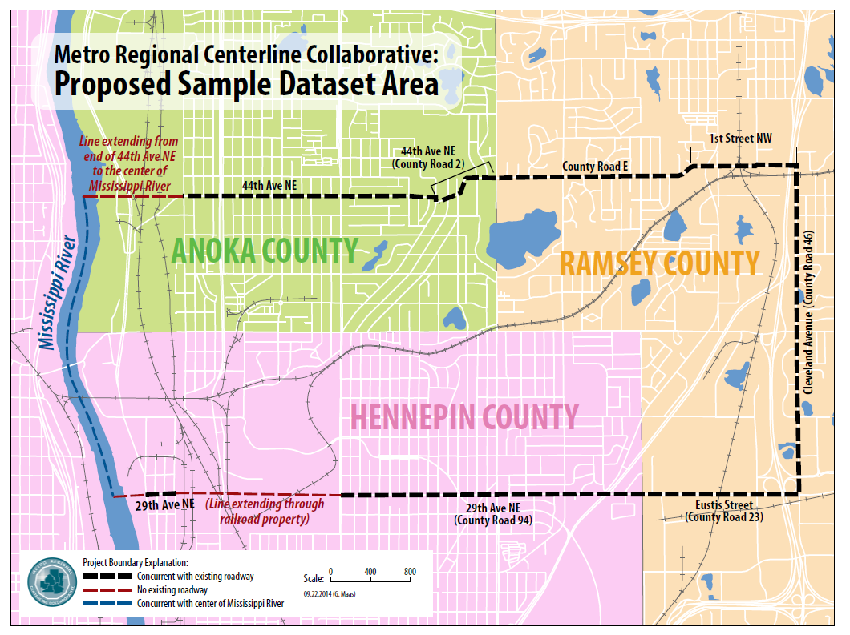

Slide 68
Pilot project area(s) for MSGP
Some considerations for selection criteria:
A diverse mix of stormwater features
Natural and artificial features
Urban, suburban, rural landscapes
Inter-municipal
Inter-county
Watershed district considerations
Willingness/openness to participation

Slide 69
